Slide 1
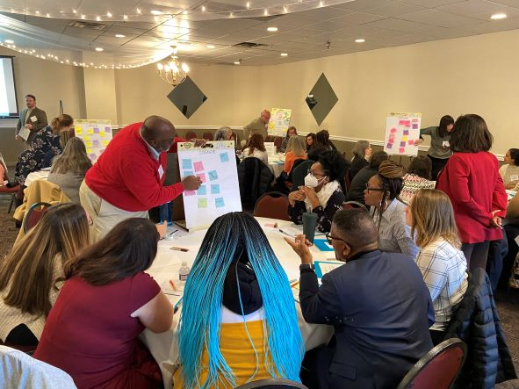
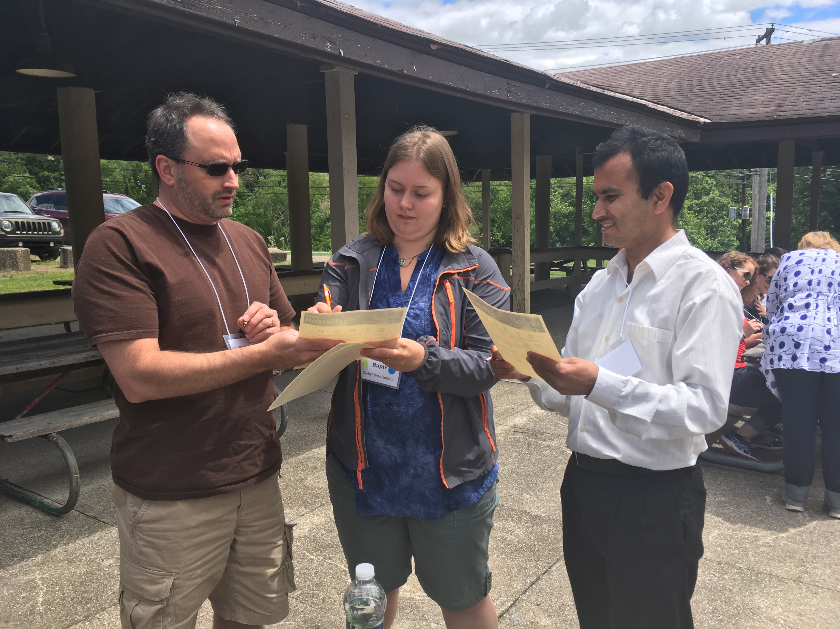
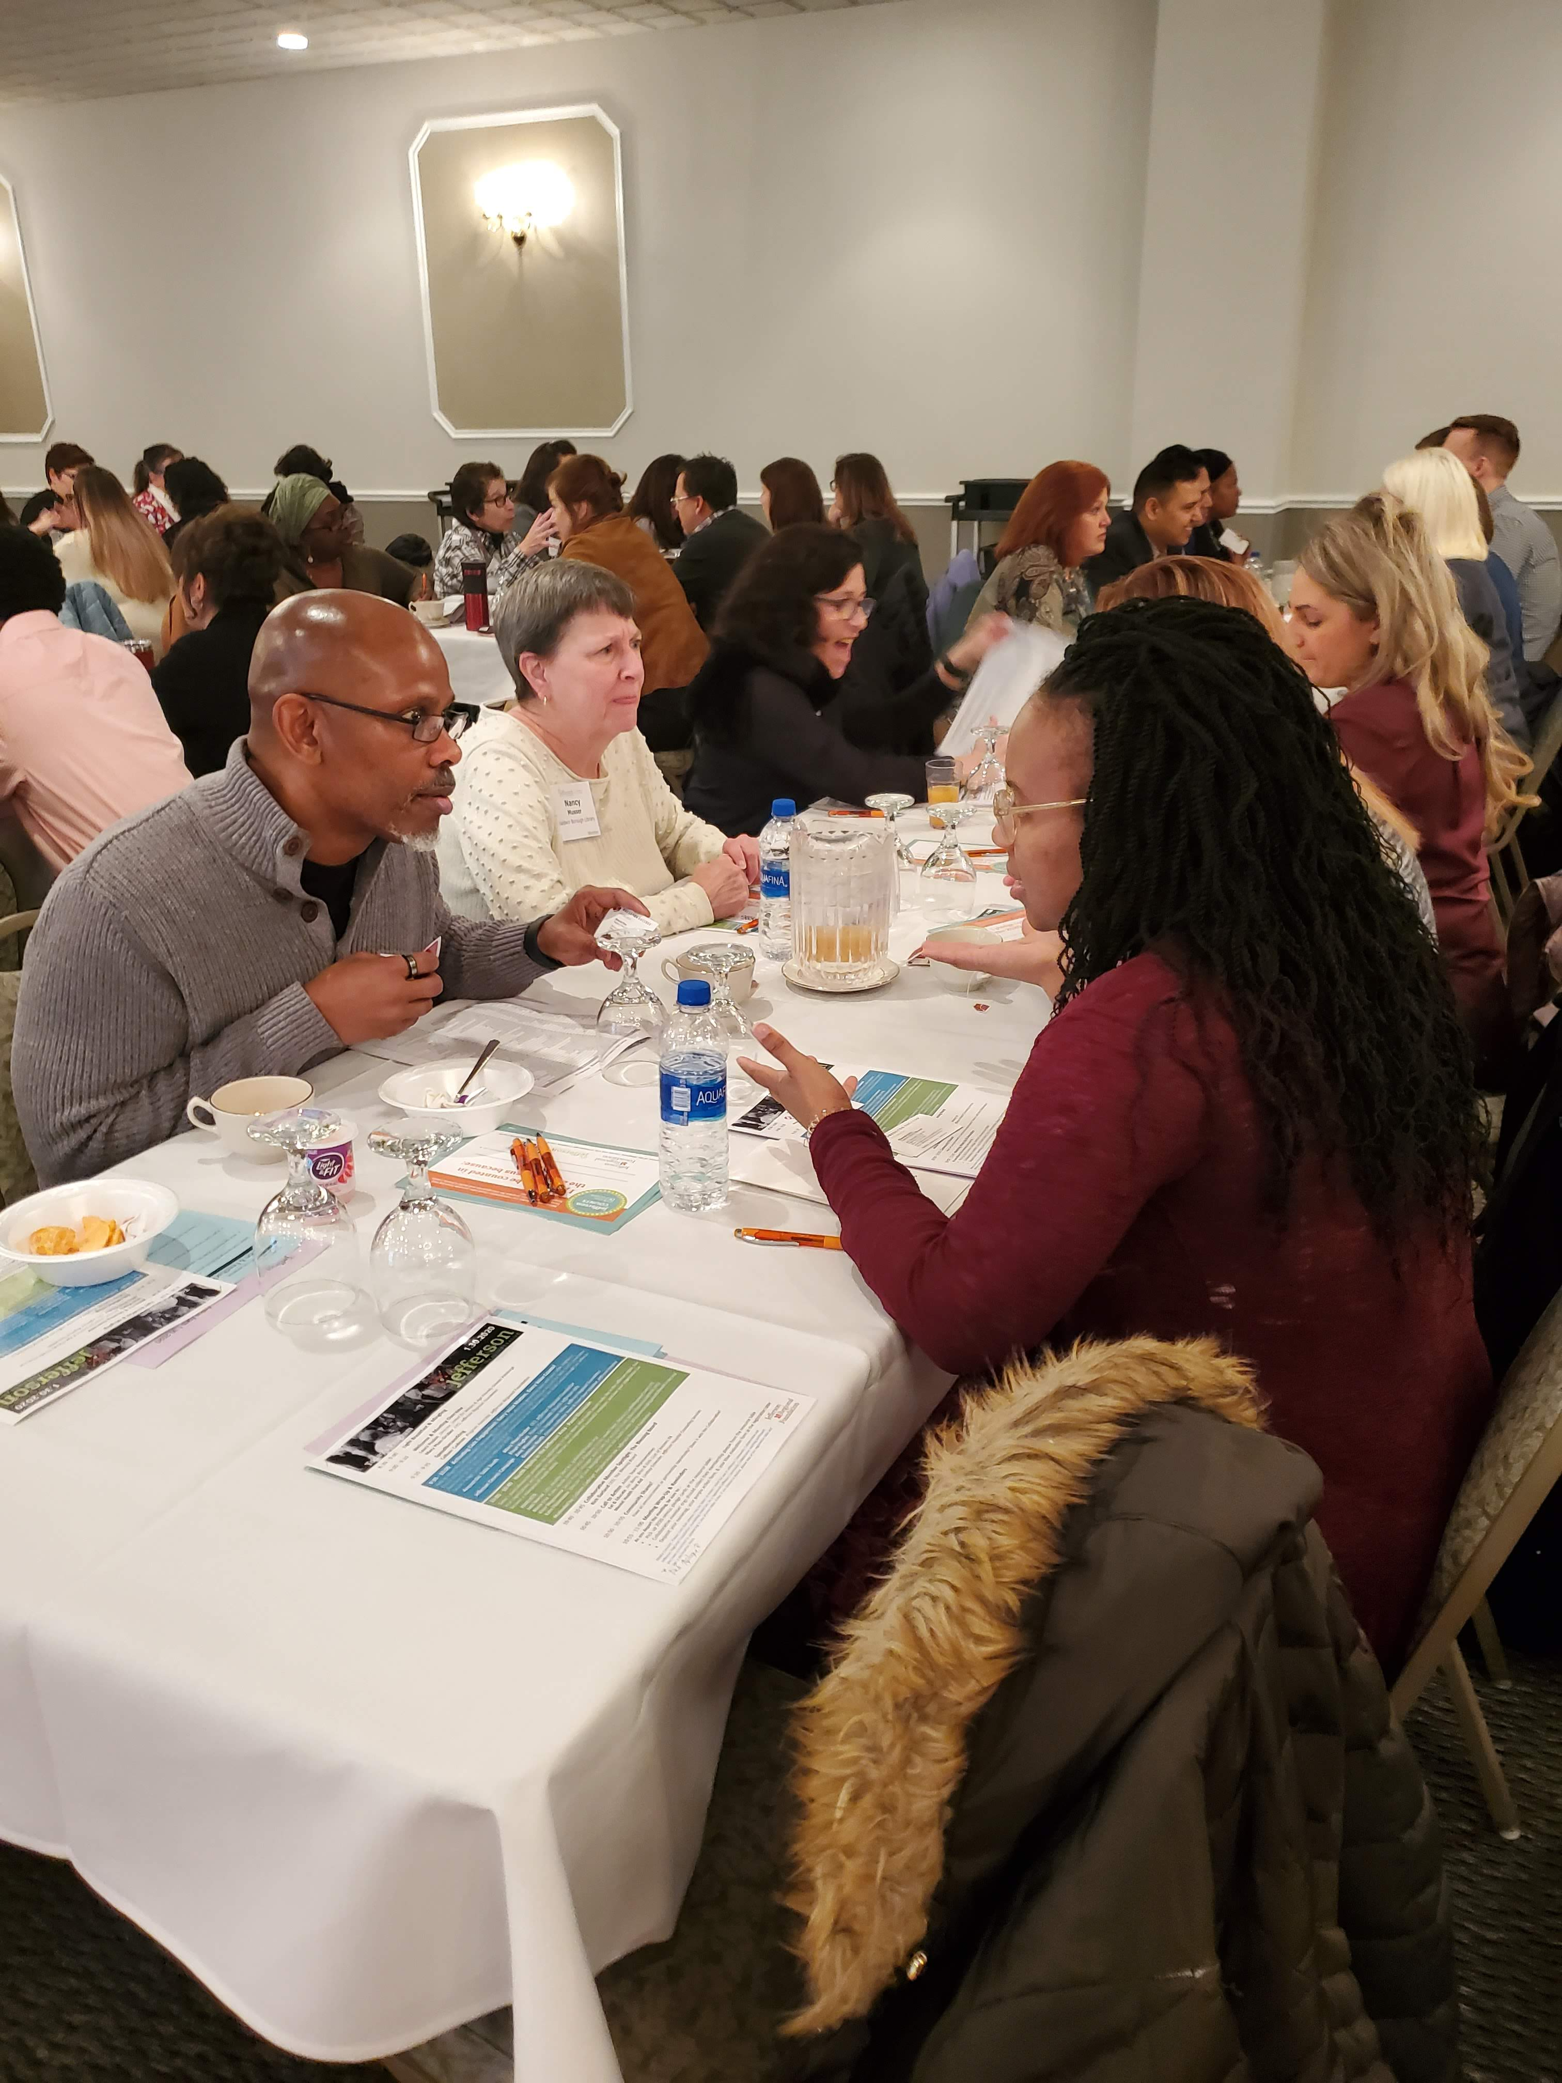
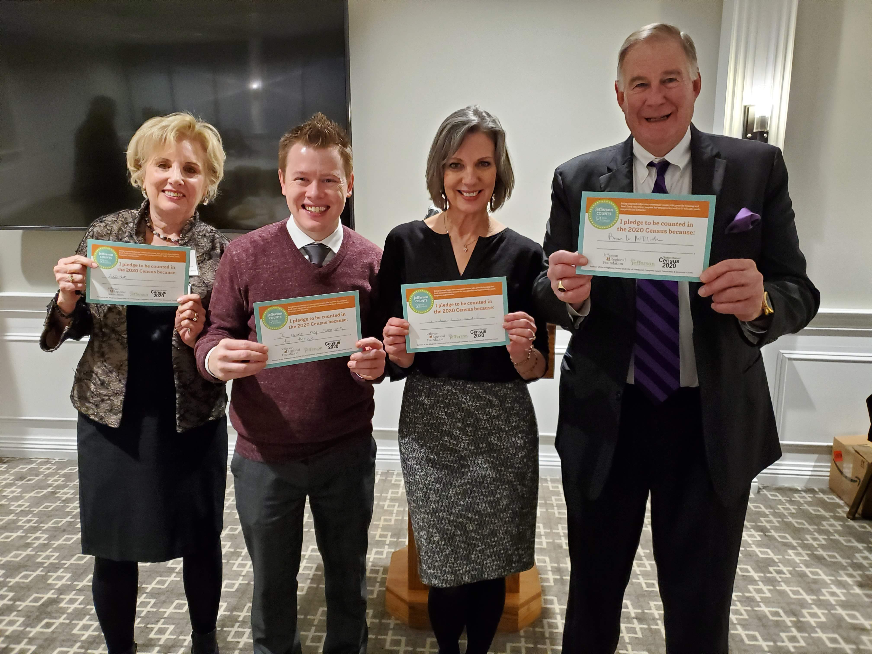
Welcome to the
Jefferson Community Collaborative Celebration: Then, Ten and Time Ahead
Wednesday, September 27, 2023 from 8:30am - 1:30pm
Crowne Plaza Suites Pittsburgh South

Slide 2
JRF 10th Anniversary
Launching Community Voice Fund
Our Changing Communities Data Story Maps
JRF Board Event
Community Snapshots
Collaborative Meeting Celebration
Hearing results of Community Voice Fund
Foundation Video
Then, Ten and Time Ahead
Notes:
As a Foundation, we are continuing our yearlong focus on the “Time Ahead” by listening to partners and community.
The “Then, Ten, & Time Ahead” anniversary provides an opportunity for a renewed focus on engaging community members while continuing to bring together not for profit community-serving organizations to positively impact and support the health and well-being of the communities within the Jefferson service area.
Launch of the Community Voice Fund – include resident energy (update Kelleigh soon)
Release of Our Changing Communities Data Story Maps (update Kelleigh soon)
Video celebrating the work of the Foundation which you will see in a moment 10th Anniversary Foundation video release (contain some of the footage shot at our last Collaborative meeting)
Event to acknowledge and celebrate the work of the JRF Board
Soon release of Community Snapshots (update Kelleigh soon)
Collaborative meeting to celebrate the work of our partners & Celebrating the work of the Collaborative and the work that you all do as community serving partners
Hearing results of CVF at November Collaborative Meeting
ALL ENCOMPASSING THE THEME OF LISTENING TO OUR PARTNERS WHICH IS ALL OF YOU AND OUR COMMUNITY

Slide 3
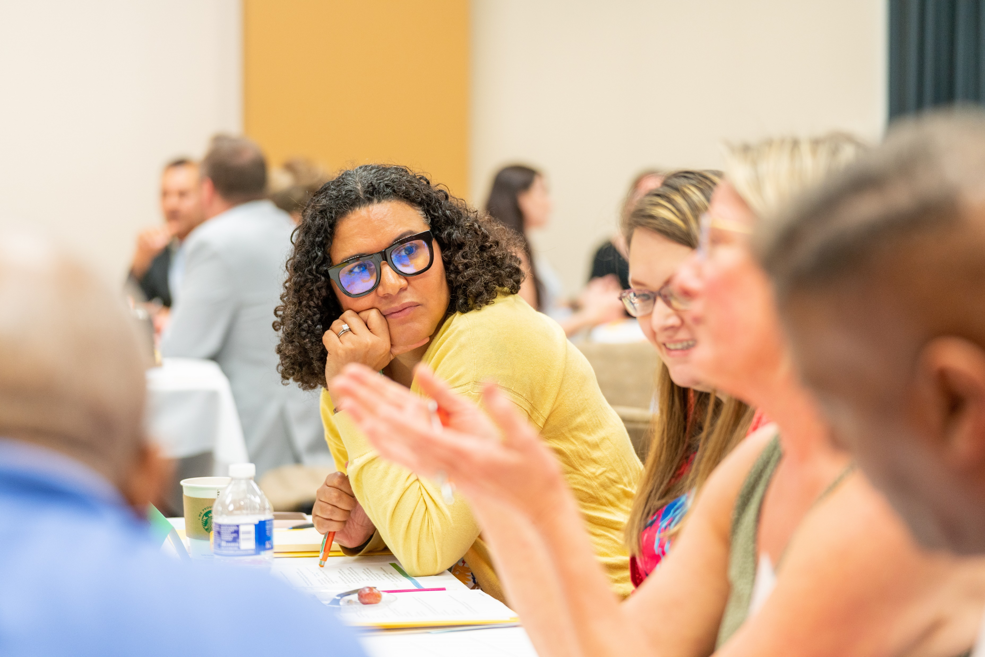
Collaborative Celebration
Objectives
Highlight community-serving organizations developing the Jefferson Community Collaborative
Highlight the ingenuity of community-serving organizations “Nonprofit Superheroes”
Offer capacity building skills and knowledge
Foster in person connection and networking opportunities

Slide 4
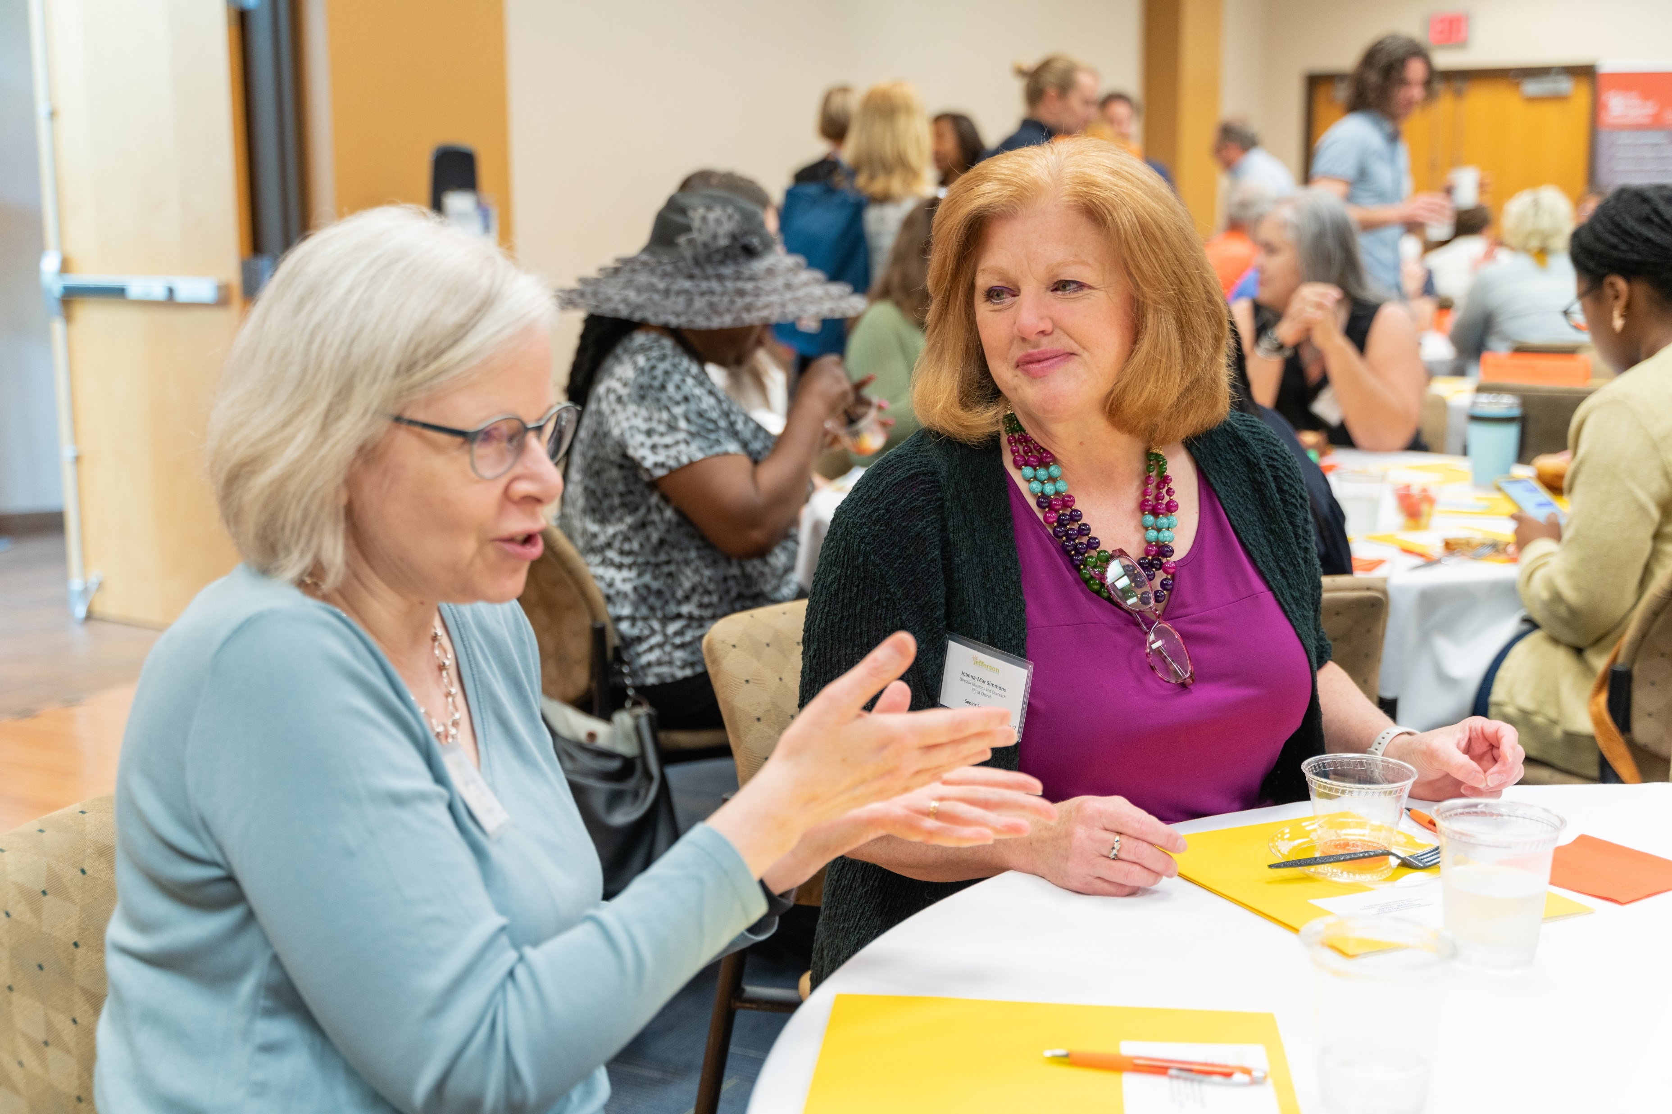
Collaborative Celebration
Celebration Overview
Fireside Chat: Celebrating the Resilience and Community Impact of Nonprofits
Skill Building Sessions
A History of Coalitions, Partnerships, and Alliances
Speed Networking – Tell Your Story with Pizzaz
Spoken Word: Fingerprints – A Legacy of Impact
Prizes, Swag, 360 Camera, SPLAT! Art Studio
The Celebration Continues…
Notes:
Fireside Chat – to kick things off with Trish moderating – Dr. Lina Dostilio and Dr. Kendra Ross celebrating the resilience and impact of nonprofits
Two Skill Building Sessions - Rotating
Speed networking with examples and telling a story with pizzaz
A History of Collaborative – Highlighting key points, coalitions, partnerships, and alliances from own collaborative connections, groups play games,
Spoken Word – FingerPrints – A Legacy of Impact with Dr. White from PSUGA
Individual and Group Prizes, JRF and Collaborative Swag, 360 Camera, Collaborative Art Project – SPLAT!

Slide 5
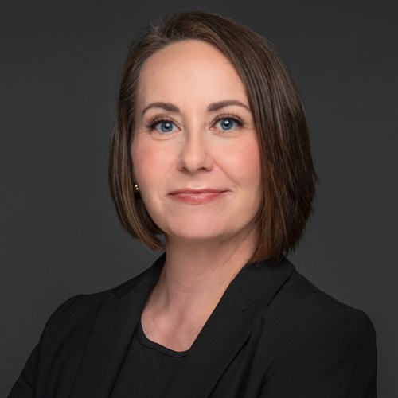
Fireside Chat: Celebrating the Resilience and Community Impacts of Nonprofits
Dr. Lina Dostilio
Vice Chancellor of Engagement and Community Affairs, University of Pittsburgh
Dr. Kendra Janelle Ross
Head of Social Impact, Duolingo
Dr. Trisha Gadson
CEO, Jefferson Regional Foundation (moderator)

Slide 6
Collaborative Celebration
And the winner is…
First Round of Individual Prizes!

Slide 7
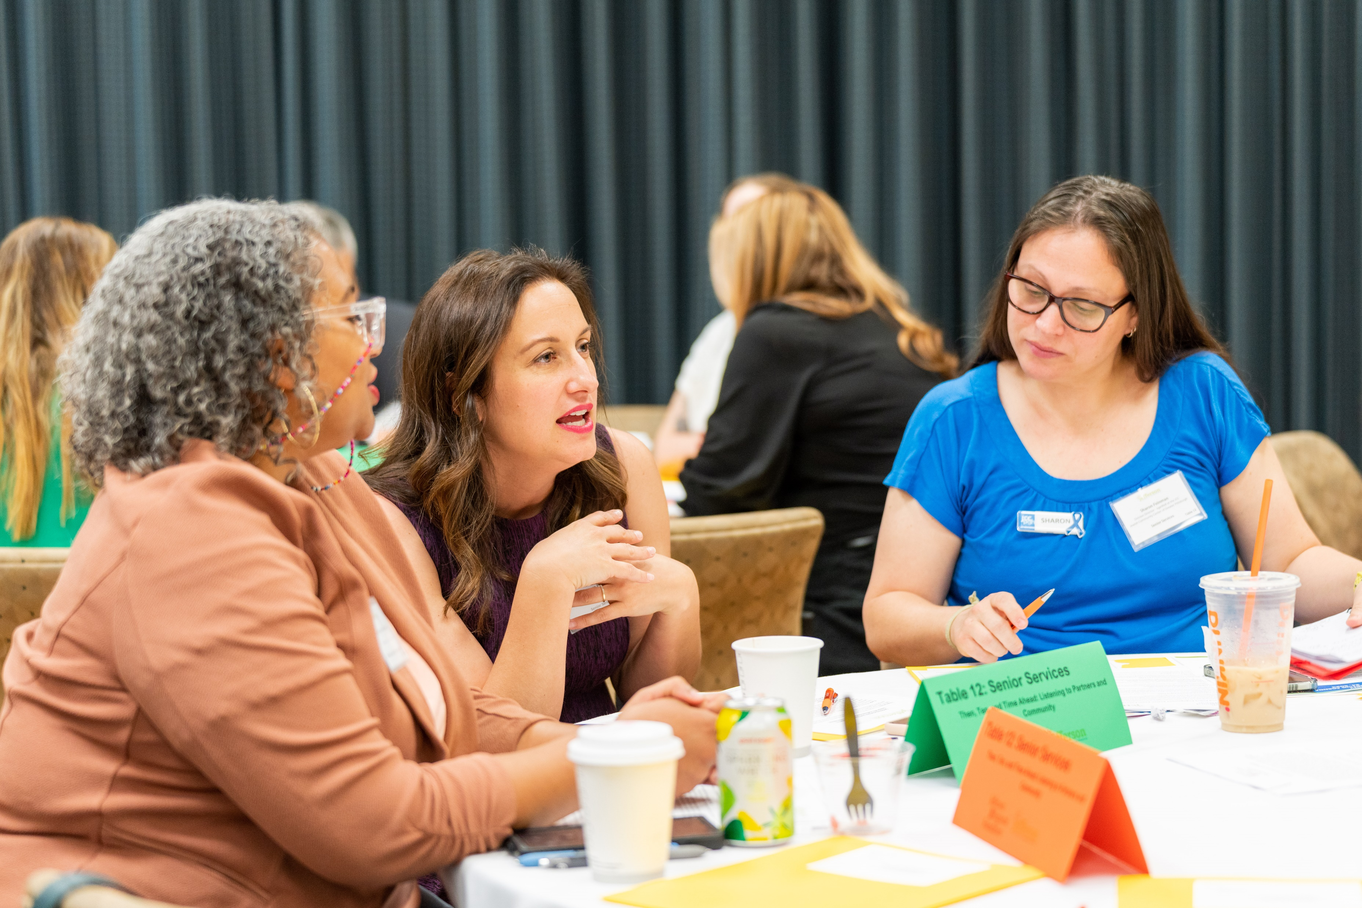
Remaining Schedule
10:10-11:50am Skill Building Sessions
10:10-10:50am Session One
10:50-11:10am Break
11:10-11:50am Session Two
12:00-12:40pm Lunch
12:45-1:15pm Closing Remarks & Spoken Word
Notes:
YOU ARE SUPERHEROES

Slide 8
Collaborative Celebration
Skill Building Sessions
Refer to Nametag for Your Group
Team Marvel: Steve Ankney and Tyler Wheeler (Jefferson Community Collaborative: A History of Coalitions, Partnerships, and Alliances)
Dismiss by groups:
Team DC: Kelleigh Boland (Speed Networking – Tell Your Story with Pizzazz)

Slide 9
Collaborative Celebration
And the winner is…
Second Round of Individual Prizes!

Slide 10
Collaborative Celebration
And the winner is…
Third Round of Individual Prizes!

Slide 11
Collaborative Celebration
And the winner is…
Organization Prize Winners!

Slide 12
Time Ahead:
Capacity Building Investment
We want to HEAR from you
Complete survey in your folder
We want to SUPPORT you
Launch in early 2024
Diverse Engagement activities
Leave completed survey at table
Individual & group
In-person & online
Short & extended timeframes
Notes:
Kelleigh Boland-Also complete the end of day survey and leaving it at the table.
While we are still planning a larger launch, our capacity building investment begins today! We will randomly choose 15 organizations who registered to be with us today and sponsor 1 employee from each organization to attend the GPNP 2023 GPNP Summit: Transformative Leadership, Partnership, and Co-creation. If your organization is chosen, you will be contacted by Foundation staff in the coming days.

Slide 13
Next Collaborative Meeting: Thursday, November 30
CCAC South Campus (8:30-11:00am)
Community Voice Fund Report Out

Slide 14
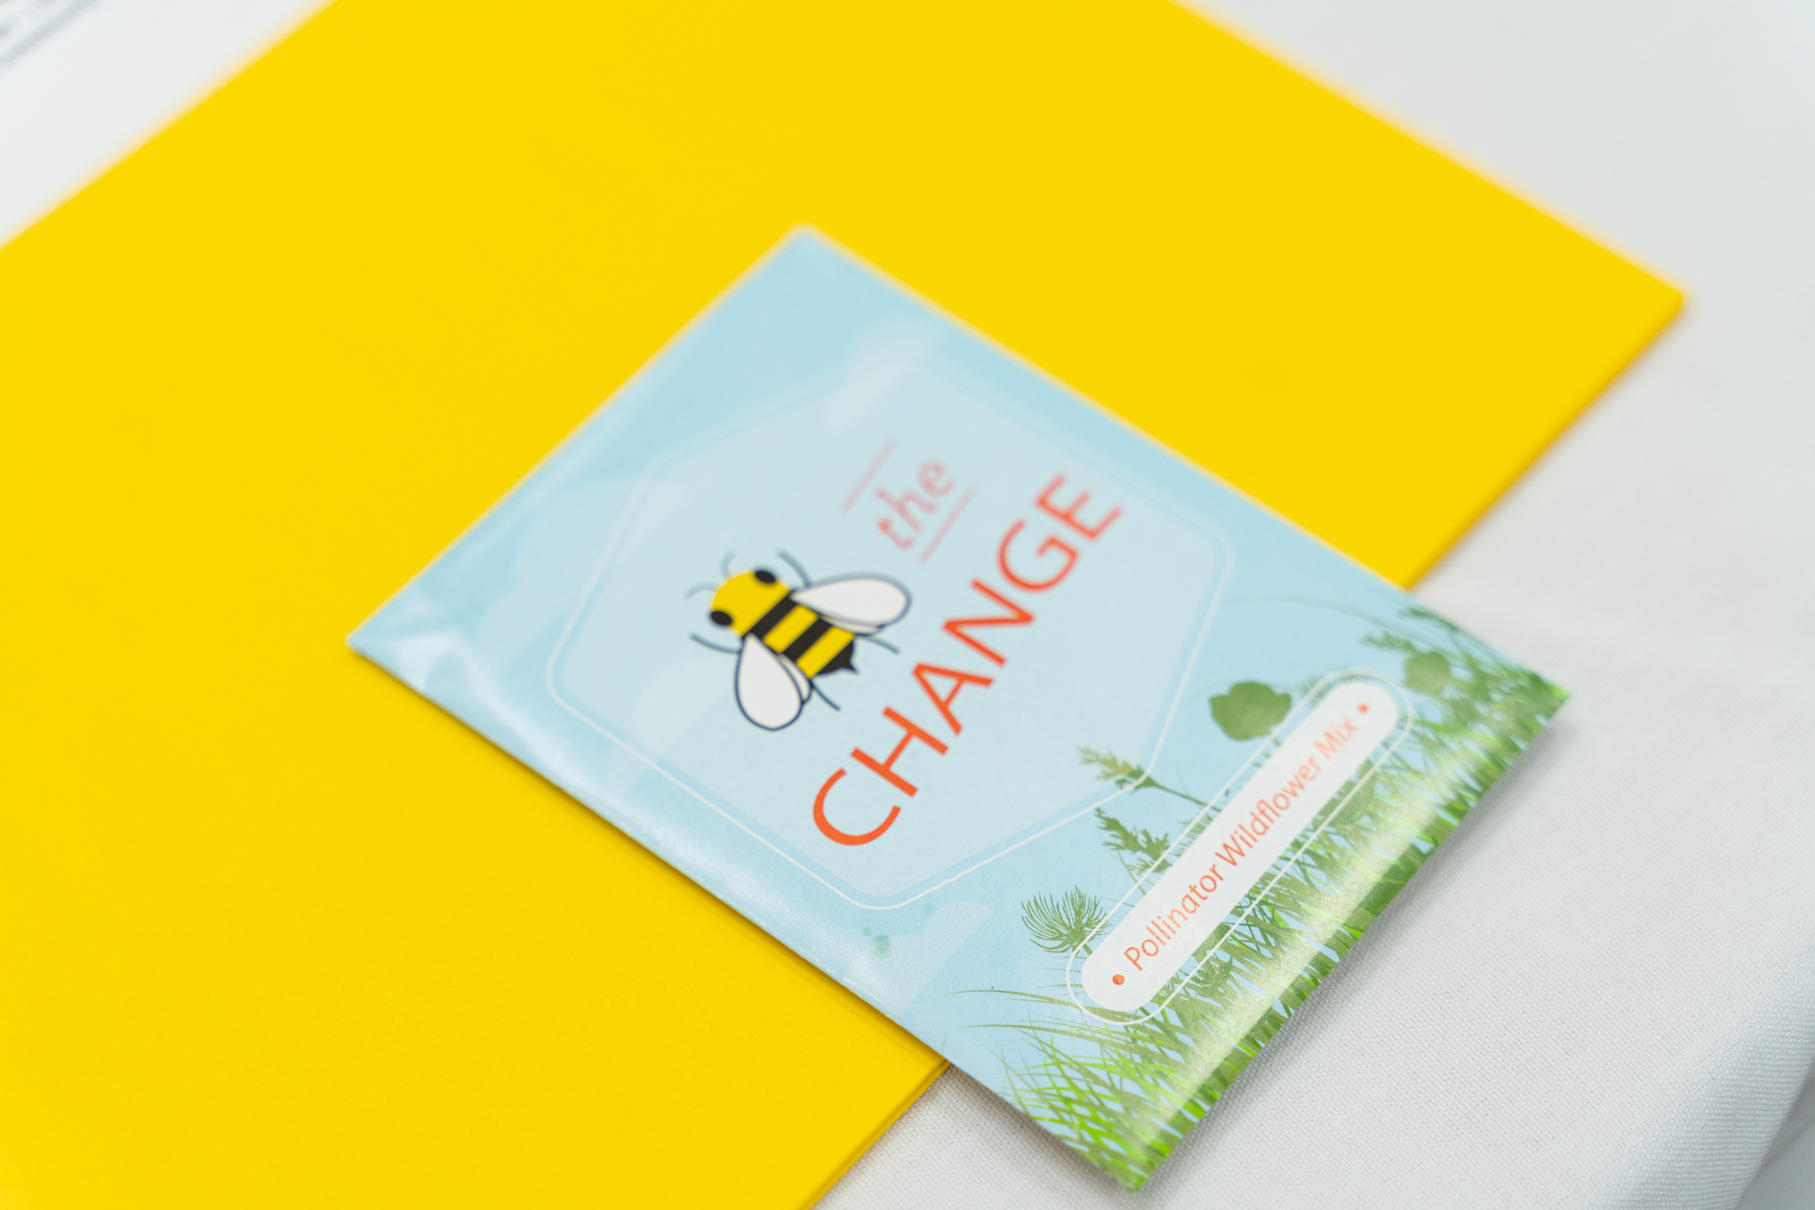
Collaborative Celebration
Before You Leave
360 Camera
Swag
Collaborative Art Project
Surveys

Slide 15
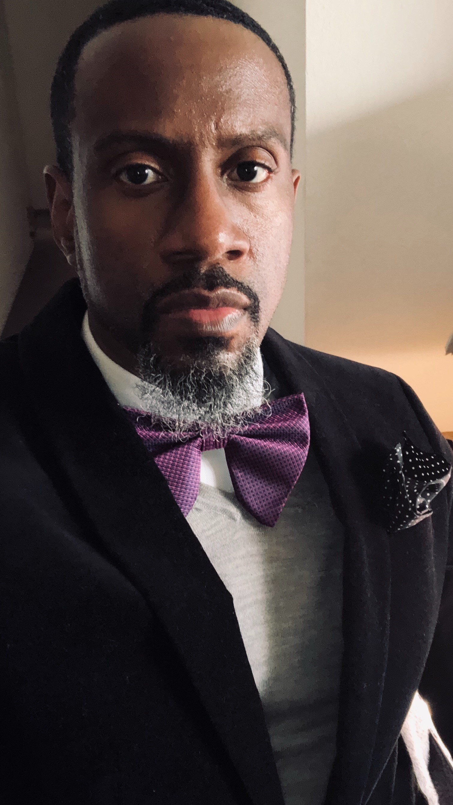
Spoken Word
FingerPrints – A Legacy of Impact
Dr. Johnathan White
Associate Teaching Professor, U.S. and African-American Studies and Co-Director, Stewart and Jones Scholar-Leadership Program, Penn State Greater Allegheny

Slide 16
Thank you for being superheroes by working in partnership with communities!

