Slide 1
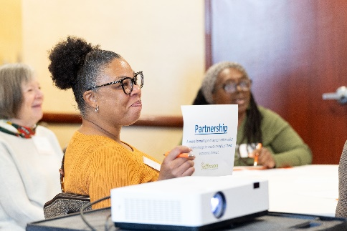
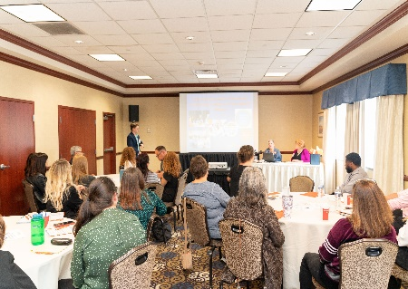
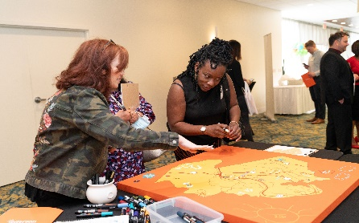
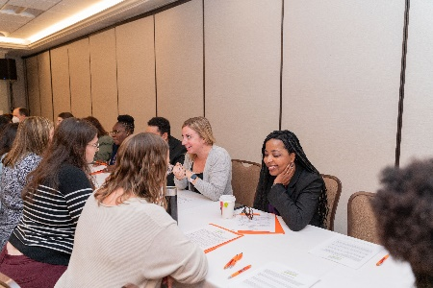
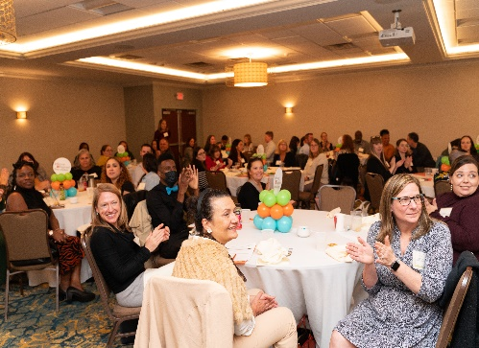
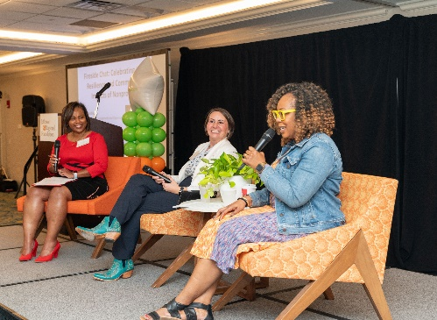
Jefferson Community Collaborative Meeting
Friday, September 20, 2024
8:30-11:00am at Salvatore’s
Notes:
Welcome and thank you for making the time to join us for the Jefferson Community Collaborative Meeting. We are so excited to have you!
Jefferson Community Collaborative is an initiative and investment of the Jefferson Regional Foundation.
Danny Vereb, my pronouns are he/him/his and I am the Community Engagement Manager with JRF
Thank you to Salvatore’s for hosting us today – we are so excited to be welcoming you all here in Baldwin.

Slide 2
Meeting Goals
Strategic Plan
Comms Strategy
Mon Valley Clean Air Fund
Grant Priorities
Capacity Building
DEIRJ
Vision Council
Jefferson Votes
Notes:
So what are our goals for the meeting – why have we asked you here today and what information do we have to impart? (IN FOLDERS AGENDA)
Review the Jefferson Regional Foundation’s updated strategic plan and communications strategy.
Obtain details about the Mon Valley Clean Air Fund convenings, scheduled for October.
Receive information about the Foundation’s updated grantmaking priorities, process and application.
Learn about capacity-building opportunities.
Obtain an update on the Diversity, Equity, Inclusion and Racial Justice (DEIRJ) Action Team’s recent activities and initiatives.
Welcome new Vision Council members.
Review Jefferson Votes materials and how nonpartisan voter engagement promotes community health and well-being.
Discuss and share what nonpartisan activities your organization is doing to engage voters.
Folders in Front of You:
Lefthand Side:
Agenda for the Meeting (QR Code – List of Attendees and Meeting Survey)
Strategic Plan One-Pager
Righthand Side:
Document – Why Nonprofit Organizations
Flyer – MVCAF Convenings in October

Slide 3
Meeting Overview
Agenda
8:45 – 9:15am: Foundation Updates
9:15 – 9:30am: Grantmaking Updates
9:45 – 9:50am: New Vision Council Members
10:50 – 11:00am: Community Shares
9:30 – 9:40am: Grants Application Portal
9:40 – 9:45am: DEIRJ Update
9:50 – 10:50am: Jefferson Votes & Community Health
Notes:
Our day today looks like this:
8:45-9:15 - Welcome CEO, Dr. Trisha Gadson to provide and update on the Communications and Rebranding as well as the Foundation Strategic Plan and MVCAF
9:15-9:30 – Kelleigh, Director of Grantmaking and Strategy to review MVCAF convening schedule, capacity building opportunities and grantmaking priorities
9:30-9:40 – Steve Ankey, Grants, Evaluation and Data Manager to discuss the updated grand application portal
9:40-9:45 – Diversity, Equity Inclusion and Racial Justice member Dr. Howell from Mon Valley Initiative share the work of the DEIRJ Action Team
9:45-9:50 – Eric Ewell and Jeanna-Mar Simmons (VC members) introduce and welcome new VC members
9:50-10:50 – Discuss how nonpartisan voter engagement promotes community health and well being, play a little game, share the updated Jefferson Votes materials and participate in table discussions around nonpartisan voter engagement
10:50-11:00 – End the day with Community Shares and Final Announcements
We have a lot to cover so without further ado, I would like to introduce Dr. Trisha Gadson!

Slide 4
Foundation Updates
Dr. Trisha Gadson, CEO, Jefferson Regional Foundation
Notes:
Trish

Slide 5
Communications and Rebranding
Notes:
Trish

Slide 6
JRF and Collaborative Logos
Notes:
Trish

Slide 7
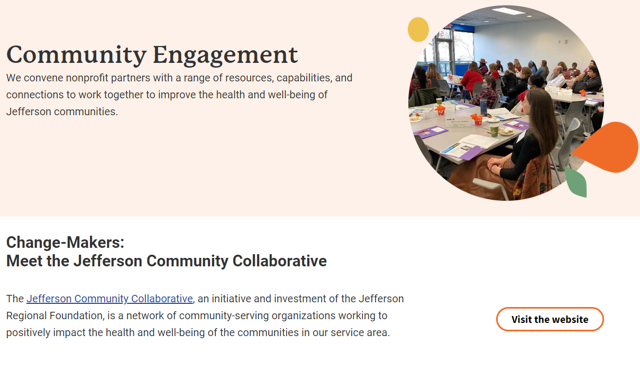
JRF Website
Notes:
Trish

Slide 8
Online Assets
Notes:
Trish

Slide 9
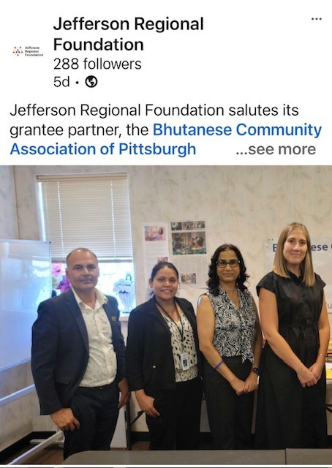
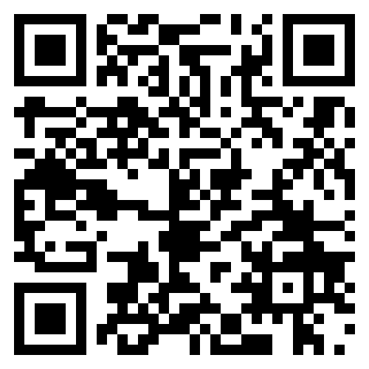
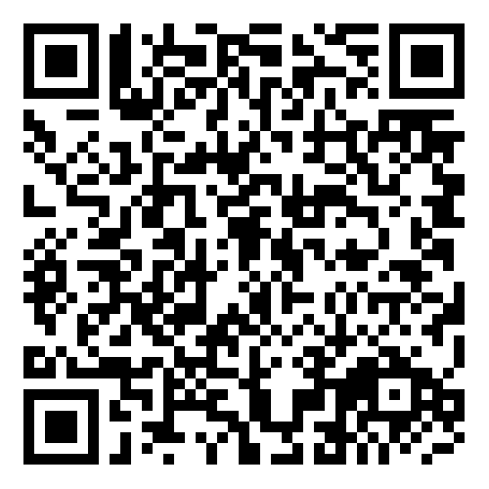
Online Assets
Scan the QR codes and follow us!
Tag your pictures from today’s Collaborative meeting using #JeffersonVotes
Notes:
Trish

Slide 10
JRF Strategic Plan
Notes:
Trish

Slide 11
Three Pillars of Work
Grantmaking
Community Engagement
Community-Driven Research
Notes:
Trish

Slide 12
Operating Principles
Approaching work through an equity lens and inclusivity
Investing grant resources with effective community partners
Promoting integrity and transparency with community
Partnering with organizations and leaders who share our vision
Managing and investing Foundation’s funds
Notes:
Trish

Slide 13
Operating Principles (cont.)
Sharing information about community resources and needs
Building the capacity of community groups
Supporting AHN Jefferson Hospital by focusing on the social determinants of health
Supporting the development of programs that demonstrate promising practices
Notes:
Trish

Slide 14
Commitment to Equity
Diversity
The representation of all our varied identities and differences collectively and as individuals.
Equity
Ensuring unhindered access to resources, information, and opportunities for individuals and communities to prosper.
Inclusion
Sharing power to create a culture of authentic participation and contributions. We measure our effectiveness through a sense of belonging where people feel seen, connected, and supported.
Notes:
Trish

Slide 15
Commitment to Equity (cont.)
Accessibility
Intentional commitment to enable participation that takes into account human ability and experience.
Justice
Corrective action to eliminate barriers by reforming practices, policies, laws, and regulations. We acknowledge that race alone and the intersection of identities disproportionately influence life outcomes. Further, we believe people have the right to live and thrive in communities free of a disproportionate burden of harmful environmental conditions. Hence, racial and environmental justice work are embedded in our practice.
Notes:
Trish

Slide 16
3 Organizational Goals
Intentionally leverage and distribute resources to equitably support the current and emerging needs of the Jefferson Hospital service area
Integrate community voice and partnerships across all aspects of work
Prioritize organizational excellence as a model for innovative philanthropy
Notes:
Trish

Slide 17
Mon Valley Clean Air Fund
Notes:
Trish

Slide 18
Mon Valley Clean Air Fund
A settlement due to Litigation between PennEnvironment, Clean Air Council, Allegheny County Health Department vs. U.S. Steel resulting in an agreement from U.S. Steel to pay $5 Million in settlement funds.
ACHD asked Jefferson Regional Foundation to distribute $2.25 Million of the settlement funds via grantmaking.
Notes:
Trish

Slide 19
Mon Valley Clean Air Fund Important Facts
JRF was not part of the litigation.
This fund is called the Mon Valley Clean Air Fund.
Communities included that are part of the JRF footprint are:
Clairton, Dravosburg, Duquesne, Elizabeth Borough, Elizabeth Township, Forward, Glassport, Jefferson Hills, Liberty, Lincoln, McKeesport, Pleasant Hills, Port Vue, Versailles, West Elizabeth and West Mifflin.
Additional Communities that will be included for this fund are:
Braddock, East McKeesport, East Pittsburgh, North Braddock, North Versailles & Wall
Notes:
Trish

Slide 20
Mon Valley Clean Air Fund Important Facts
Funds will be released from U.S. Steel over a period of 5 years resulting in $450,000 per year.
Grants will be available by application to nonprofit organizations serving the aforementioned areas. JRF’s commitment is to engage and elevate resident voice when planning begins.
PURPOSE AS DICTATED BY SETTLEMENT: To fund public health and/or air quality improvement projects in the impacted communities listed.
Notes:
Trish

Slide 21
Grantmaking Updates
Kelleigh Boland, Director of Grantmaking and Strategy, Jefferson Regional Foundation

Slide 22
Mon Valley Clean Air Fund Listening Sessions
The Foundation centers on community voice. We want to hear ideas about the use of the settlement funds.
Wednesday, October 9th from 10am-11:30am at Noah's Ark Community Center, 200 6th Street McKeesport, PA 15132. Refreshments will be provided.
Wednesday, October 16th from 12pm-1pm via Zoom (virtual meeting- registration is required)
Wednesday, October 23rd from 6pm-7:30pm at Woodland Hills School District Administrative Offices, 531 Jones Ave, Braddock, PA 15104. Refreshments will be provided.
Notes:
Child-friendly activities will be provided. Reference flyer in folder. All are welcome, registration not required, but encouraged if possible.

Slide 23
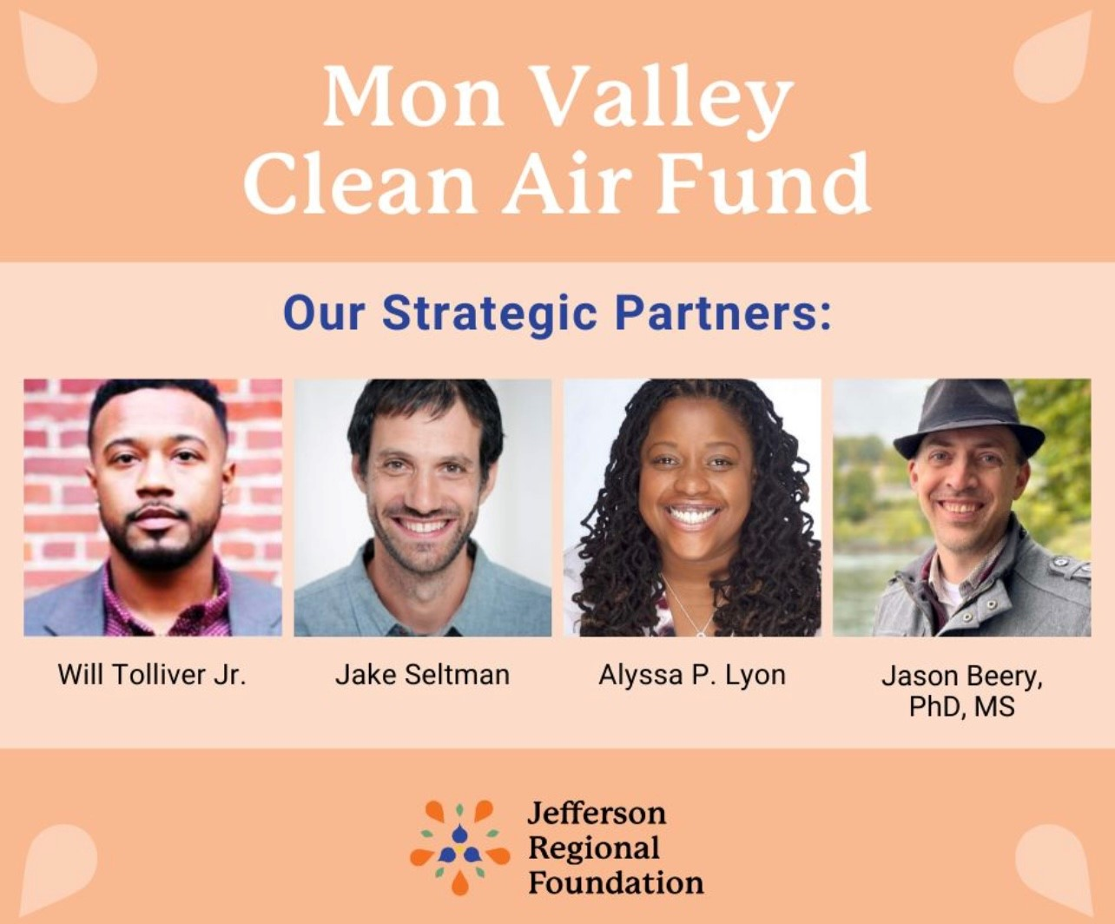

Slide 24
HR Capacity Building Opportunity
Training on creating job descriptions through Acuity Human Resources LLC.
Targeted to orgs with budgets less than or approximately $1mil
Training on October 30th from 9am-11:30am in Foundation offices. Orgs will also receive a 30-minute individualized phone or video session.
Maximum of 20 organizations
Registration will be sent out the week of Sept. 23rd

Slide 25
Grantmaking- Revised Funding Priorities 2024-2025
Health and Wellness (physical, mental, behavioral, and environmental health and basic needs including food, housing, and transportation)
Education, Workforce, & Economic Opportunity (early childhood/literacy, youth development, training, and youth, adult, and community education)
Community Engagement & Policy Work (advocacy, civic engagement, and organizing)

Slide 26
Updated Grants Application Portal
Steve Ankney, Grants, Evaluation, and Data Manager, Jefferson Regional Foundation

Slide 27
JRF’s New Grant Portal Timeline
Hosted a grantee focus group in February 2024
Tested grant portal with past grantees
New, user-friendly portal w/focus on equity and community engagement
Notes:
- Focus on equity and community engagement enables us to track JRF’s reach and impact

Slide 28
Feedback from Grantee Partners
Character limits, saving issues, and repeated contacts from JRF staff could be burdensome for grantees.
The new system:
Increased character limits
Better autosave feature
Revised questions for more effective storytelling

Slide 29
The Foundation launched the new Grant Portal on September 6th! The new system is called GOapply
JRF
GOapply
Express
Notes:
- Notice all of the people cheering excitedly at the launch of our new GOapply grant portal!

Slide 30
GOapply Grant Portal Features
Multiple users from organizations can work on materials together through their own separate individual user accounts
A word document of proposal questions is available on our website
More information about the GOapply grant portal can be found on the Foundation’s website
Notes:
Why is this important?
Word doc from feedback.

Slide 31
For Consideration
eGrant is going away on January 1st. Materials submitted through eGrant will no longer be available on that platform
Partners can contact Steve to request previous LOIs, Proposals, and Reports.
When partners are invited to submit proposals, JRF staff will help you create GOapply portal accounts!
Notes:
- Users can also create accounts on their own with instructions on our website.

Slide 32
Feedback & Updates
JRF is committed to continuous improvement and feedback
Opportunities for feedback on LOIs, Proposals, Reports
We invite you to share any other feedback you have directly with us
Visit the Foundation’s website for additional information
stephen.ankney@jeffersonrf.org
412-990-7116
https://jeffersonrf.org/

Slide 33
An Update From the Diversity, Equity, Inclusion and Racial Justice (DEIRJ) Action Team
Dr. Charles Howell, Director of Workforce Development and Financial Coaching, Mon Valley Initiative
Notes:
An Update From DEIRJ
Dr. Charles Howell, Director of Workforce Development and Financial Coaching, Mon Valley Initiative
Steve Ankney, Grants, Evaluation and Data Manager, JRF will introduce you following his presentation of the updated grants application portal.
Next Slide:
Introduce yourself (organization and title).
Share that you are a member of the DEIRJ Action Team.

Slide 34
DEIRJ Moving Forward
Collaborative Partner DEI Survey (May 2024 Collaborative)
Opportunities for continued DEIA work
Racial Wealth Gap Simulation: November 21 Collaborative Meeting (United Way of SWPA)
DEIA Workshops: Spring 2025 (YWCA)
Collaborative Meetings Moving Forward: Partner DEIA Spotlights
Outlining a recruitment process for DEIRJ
Notes:
Next Slide:
I am here to share an update from the Diversity, Equity, Inclusion and Racial Justice (DEIRJ) Action Team.
For those of you who attended our most recent Collaborative meeting in May 2024, you will remember the focus of that meeting was on the landscape of DEI and implications for community practice.
At that meeting, we asked partners to participate in table discussions focused on future learning opportunities around DEI.
We also asked partners to complete a survey regarding continued DEI support for nonprofit partners. Thank you to those who completed the survey.
The DEIRJ Action Team met in July to discuss the results of the survey and found that overwhelmingly nonprofit partners were looking for additional information regarding how to incorporate DEI activities into their daily work – bake it in.
As such, the DEIRJ Action Team will be providing two specific learning opportunities for nonprofit partners that we hope will help meet these requests.
The first is a Racial Wealth Gap Simulation at the November 21 Collaborative meeting.
This highly engaged simulation will be conducted by the United Way of Southwestern Pennsylvania. The simulation focuses on understanding the underlying factors that created inequities through 13 different policies and practices that have contributed to the racial wealth gap.
In addition, in Spring 2025, three workshops will be provided through the YWCA to help support the incorporation of DEI into the workplace. These workshops include:
Microaggressions 101: A Thousand Cuts
Spheres of Influence
Institutional Racism
Finally, to those individuals who identified that they would like to highlight promising practices around DEIA within their workplace, we will begin to spotlight these organizations at Collaborative meetings moving forward.
For anyone interested in becoming a member of the DEIRJ Action Team, we are beginning discussions around an equitable recruitment process and will report out to you soon.
Thank you for your time today. I would like to turn things over now to Eric Ewell and Jeanna-Mar Simmons who will welcome our new Vision Council members.

Slide 35
Introducing New Vision Council Members
Eric Ewell, CEO, Community Foundations Consulting LLC.
Jeanna-Mar Simmons
Notes:
Introducing New Vision Council Members
Eric Ewell, Jeanna-Mar Simmons
Dr. Howell will introduce you following the DEIRJ Update.
Next Slide (ALL):
Introduce yourselves.
Share how long you have been a member of the Vision Council.

Slide 36
Vision Council Interview Process
19 Applicants for 5 Council Positions
Collaborative Focus
Organization Level
Jefferson Footprint
Community Voice
Notes:
Next Slide (Eric):
This past Spring we invited nonprofit partners to apply to become members of the Vision Council.
We want to thank the 19 individuals who took the time to apply and share their wealth of experience with us. We had extremely qualified candidates which was very exciting, but also made for a difficult selection process.
Utilizing the Vision Council member role as a guide, we focused on specific rubric when considering who would be a good fit for this advisory council:
Collaborative Focus – We were looking for partners that have an understanding of the Collaborative, attend and are involved with meetings.
Organizational Level – We were looking for individuals that represent varied levels within their organizations, not just executive level staff.
Jefferson Footprint – We were looking for applicants that live and have a deep connection within the Jefferson Service area.
Community Voice – We were looking for organizations that have a mechanism for listening to community voice.

Slide 37
Introducing New Vision Council Members
Pecola Abele (Elizabeth Twp)
Director of Healthy Living, Women for a Healthy Environment
Richard Ford (Clairton)
President, Unity Group of Clairton
Betty Karleski (Whitehall)
Community Engagement Coordinator, Veterans Breakfast Club
Markeya Lowry (Homestead)
Senior Program Manager, When She Thrives
Giulia Lozza Petrucci
Executive Director, Dragon’s Den
Notes:
Next Slide (Jeanna-Mar):
We are proud to introduce to you the five individuals who have accepted roles on the Vision Council. If you are present, please stand when I call your name:
Pecola Abele (Elizabeth Twp) - Director of Healthy Living, Women for a Healthy Environment
Richard Ford (Clairton) - President, Unity Group of Clairton
Betty Karleski (Whitehall) - Community Engagement Coordinator, Veterans Breakfast Club
Markeya Lowry (Homestead) - Senior Program Manager, When She Thrives
Giulia Lozza Petrucci - Executive Director, Dragon’s Den
As you can see, four out of our five new Vision Council members live within the Jefferson footprint. This is a step toward increased resident voice within the Vision Council.
With the addition of these new members, we now have representation within all five of the geographic subareas of the Foundation.
Please join me in welcoming these five new members to the Vision Council.
Finally, I want to acknowledge the work of the tenured Vision Council who led the charge in conceiving this process. Please stand as well and be recognized.
At this time, I’d like to turn things over to Danny Vereb who will share a little about the Jefferson Votes initiative and how nonpartisan voter engagement promotes community health and well-being.

Slide 38
Utilizing Jefferson Votes Materials to Promote Community Health and Well-Being
Danny Vereb, Community Engagement Manager, Jefferson Regional Foundation
Notes:
Me again?
I am thrilled to share information with you regarding how nonpartisan voter engagement promotes community health and well-being and how the Civic and Policy Engagement action team has worked to create resources that will assist nonprofit organizations in their nonpartisan voter engagement efforts.

Slide 39
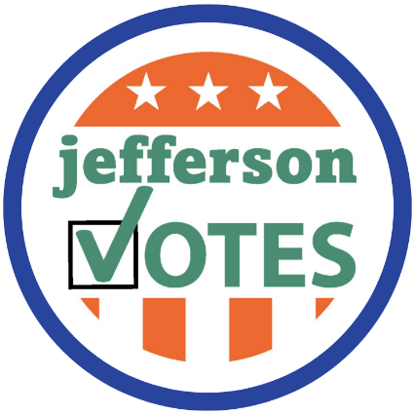
Why Nonprofits Should Participate in Nonpartisan Voter Engagement
Empowerment of Communities
Giving voice to underserved communities in decisions that affect their lives
Alignment with Mission
Amplify community well-being
Enhanced Advocacy Efforts
Educated voters shape policies and legislation that align with goals
Increased Visibility
Nonprofits are a credible source for community information
Building a Stronger Democracy
Engaged electorate = more responsive governance
Notes:
In your folders on the righthand side you will note a document entitled: Why Nonprofits…
At tables, plastic sign holders highlight each of these individual reasons.
Rather than me standing up here and sharing these points, I’m going to move around the room because nonpartisan voter engagement work is ACTIVE. But I need your help!
I will come around to each table and have a representative stand up and read the reason highlighted at their table. Ten reasons – Ten Tables – sound like fun?
Empowerment of Communities: Voter engagement helps empower individuals, particularly those from marginalized or underserved communities, by giving them a voice in decisions that affect their lives.
Alignment with Mission: Many nonprofits have missions that are closely linked to social justice, equity, and community well-being. Engaging in voter education and mobilization aligns with these core values and can amplify their impact.
Enhanced Advocacy Efforts: Active voter engagement can strengthen a nonprofit’s advocacy efforts. By educating and mobilizing voters, nonprofits can help shape policies and legislation that align with their goals.
Increased Visibility: Participation in voter engagement can enhance a nonprofit's visibility and credibility within the community. It can also attract new supporters and volunteers who are passionate about both the nonprofit’s mission and the importance of voting.
Building a Stronger Democracy: By promoting voter participation, nonprofits contribute to a healthier democracy. A more engaged electorate can lead to more representative and responsive governance.

Slide 40
Why Nonprofits Should Participate in Nonpartisan Voter Engagement
Influencing Policy Change
Elected officials are more likely to address issues that their constituents care about
Educational Opportunity
Inform community about the importance of voting and how to navigate the process
Strengthening Community Relationships
Fostering trust and collaboration between community and nonprofits
Long-Term Impact
Building a foundation for sustained civic involvement within community
Leveraging Existing Networks
Maximize impact through existing connections
Notes:
Influencing Policy Change: Voter engagement efforts can lead to policy changes that directly benefit the communities nonprofits serve. Elected officials are more likely to address issues that their constituents care about.
Educational Opportunity: Nonprofits often have strong connections with their communities and can provide valuable voter education resources, helping to inform voters about the importance of their participation and how to navigate the voting process.
Strengthening Community Relationships: Voter engagement can help build and strengthen relationships between nonprofits and their communities, fostering trust and collaboration on other issues.
Long-Term Impact: Engaging in voter outreach helps build a foundation for sustained civic involvement, which can lead to long-term positive changes in the community and support for the nonprofit’s mission.
Leveraging Existing Networks: Nonprofits often have established networks and communication channels that can be leveraged to reach and mobilize voters effectively, maximizing the impact of their efforts.

Slide 41
Nonprofit organizations support voting as indicator of individual and community health
Embed voter engagement into service delivery and advocacy
Voters are more informed and turnout increases
Leaders are in place to support community needs
A community that participates in civic engagement is a healthy community!
Notes:
OK, You Did It!
In summation:
We believe that if nonprofits as trusted entities in their communities support this work and embed it into their service offerings (hanging up posters, holding voter registration events, asking community members if they are registered to vote on intake forms), that voters are more informed and voter turnout increases.
When voter turnout increases, there are leaders in place that understand and support community needs.
WE BELIEVE THAT A COMMUNITY THAT PARTICIPATES IN CIVIC ENGAGEMENT IS A HEALTH COMMUNITY!

Slide 42
Jefferson Votes Origins
Collaborative Initiative led by the Civic and Policy Engagement Action Team and modeled after Jefferson Counts
Objectives:
Offer resources to community partners to promote voter registration and participation
Increase confidence and access to the voting process
Raise enthusiasm in the civic process to promote a more inclusive community and equitable access to resources
Jefferson Votes Webpages
Two prongs of work:
Jefferson Votes Toolkit
Notes:
Considering civic engagement as an indicator of community health and well-being, the Civic and Policy Engagement Action Team created the Jefferson Votes initiative to provide resources for nonprofit organizations around nonpartisan voter engagement.
Modeled after the 2020 Jefferson Counts Census initiative, Jefferson Votes initially launched for the 2022 general election cycle and was revamped for the 2024 general election (more cohesive & user-friendly resource)
Objectives of Jefferson Votes is to:
Offer resources to community partners to promote voter registration and participation
Increase confidence and access to the voting process
Raise enthusiasm and engagement in the civic process to promote a more inclusive community and equitable access to resources
In this updated iteration of Jefferson Votes, there are two prong to the work we are sharing with the community.
The first is the Jefferson Votes Webpages which are on the Collaborative Website (one-stop-shop for questions about voting in PA):
The next piece of the updated Jefferson Votes Initiative is the Jefferson Votes Toolkit

Slide 43
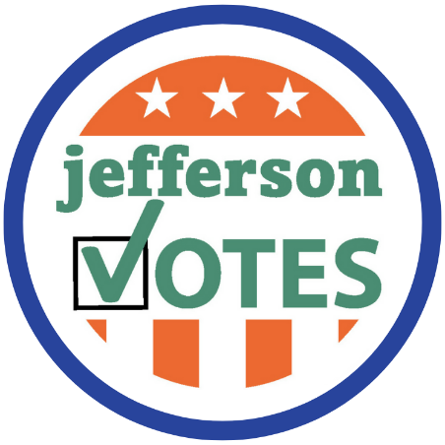
Jefferson Votes Webpages
Nonprofit Voter Engagement
First Time Voting
Know Your Options To Vote
Election Rights/Voting Security
Notes:
The first prong of the work is the Jefferson Votes Webpages which are on the Collaborative Website – there is also a QR code that links to the pages on the Why Nonprofits Should Participate in Nonpartisan Voter Engagement document that I shared in your folders.
We envision these pages as a one stop shop for questions about voting in Pennsylvania:
Why nonprofit organizations can and should engage in nonpartisan voter engagement
How to register to vote
Voting Requirements in PA
How to find polling places
Sample ballots
Mail-In and Absentee Ballot information
Information about how to update your registration if you move or change parties
Information about Election rights and voting security
Please find this one stop shop for information about voting in PA is available on the Collaborative website.
Again, right now you can link to these pages from the QR code on the “Why Nonprofits Should Participate in Nonpartisan Voter Engagement”
Check out the updated webpages for Jefferson Votes and share broadly.

Slide 44
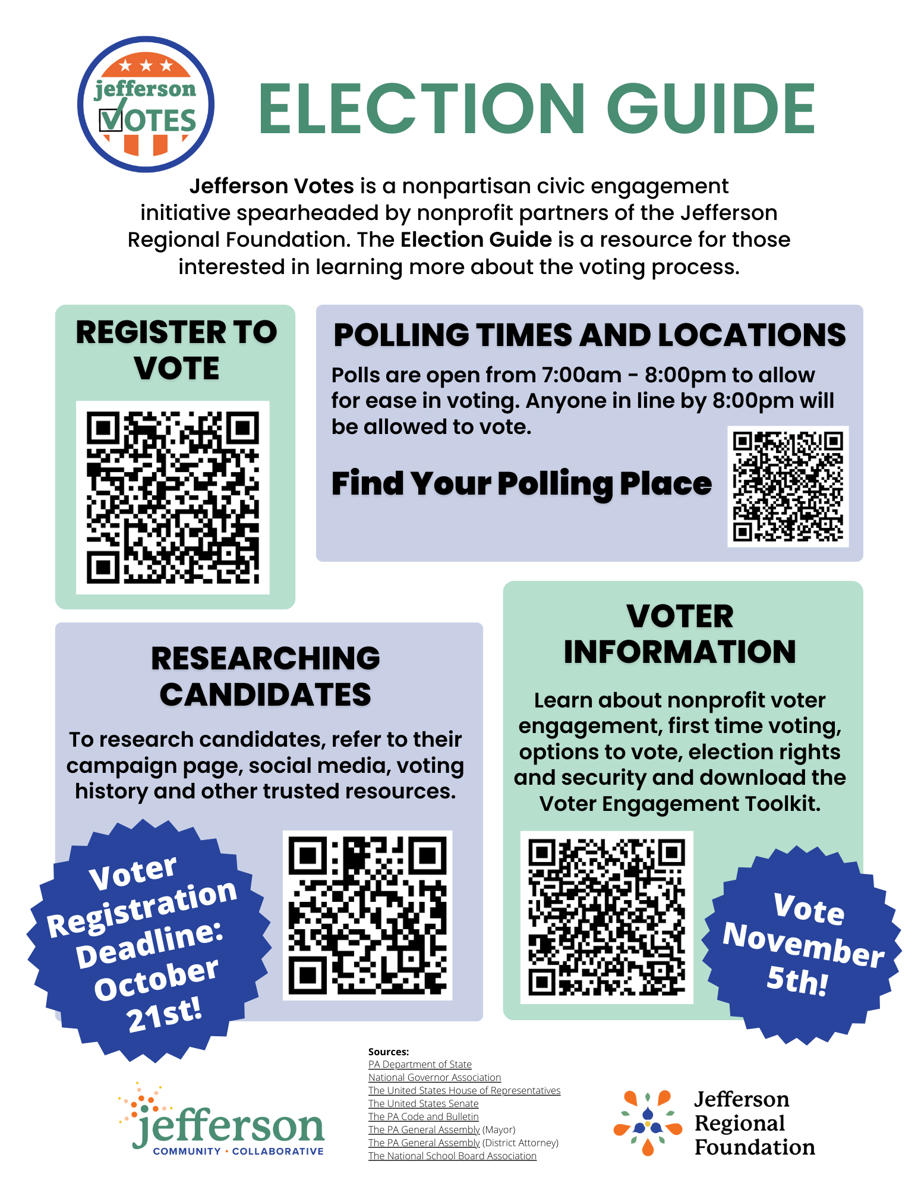
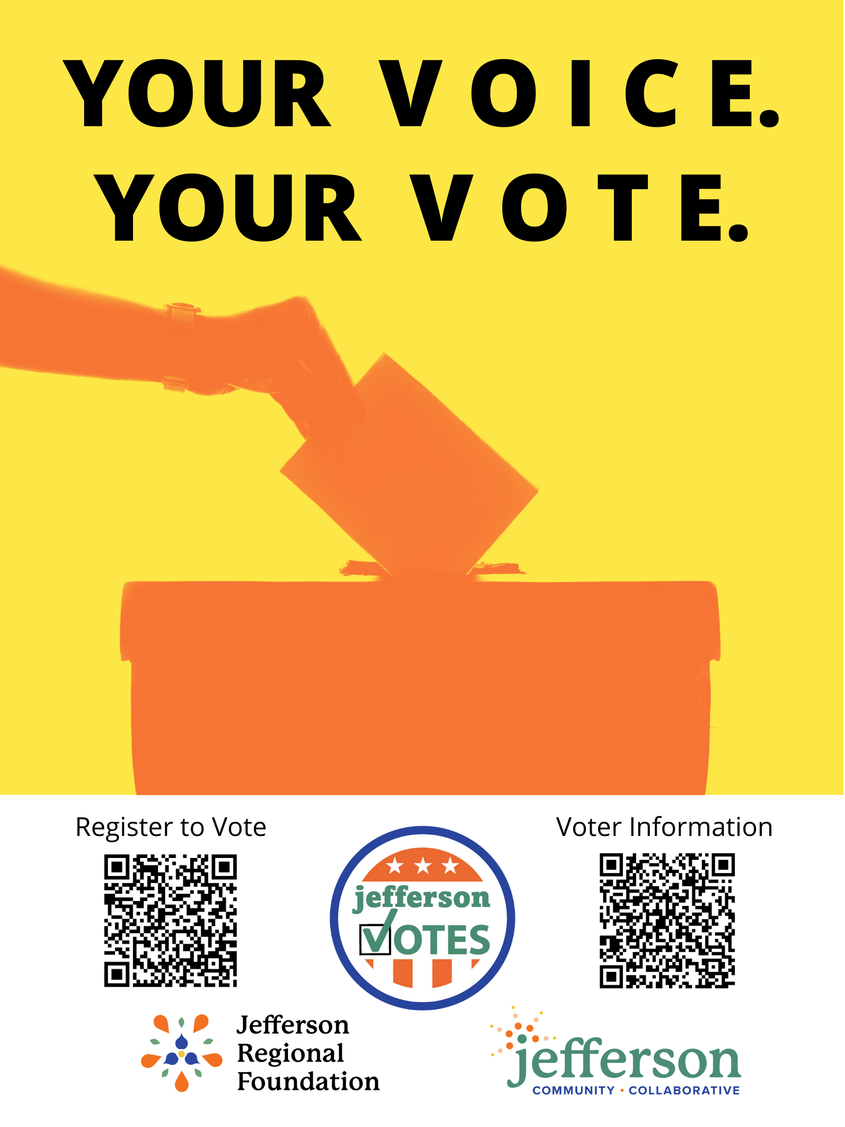
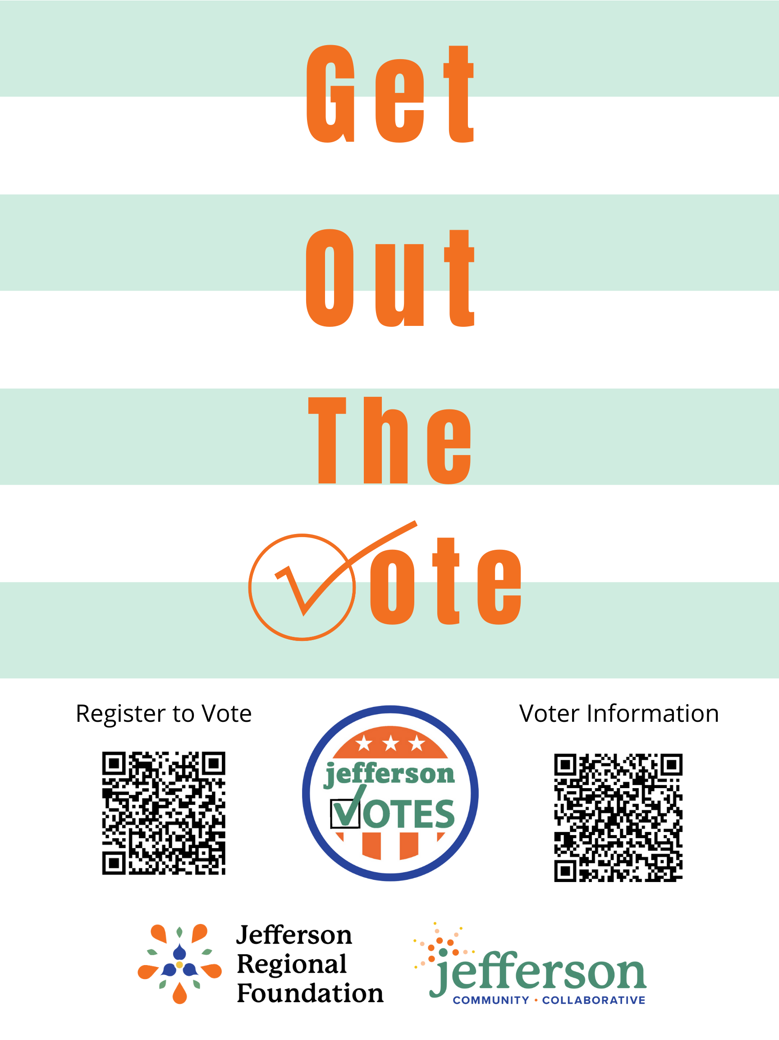
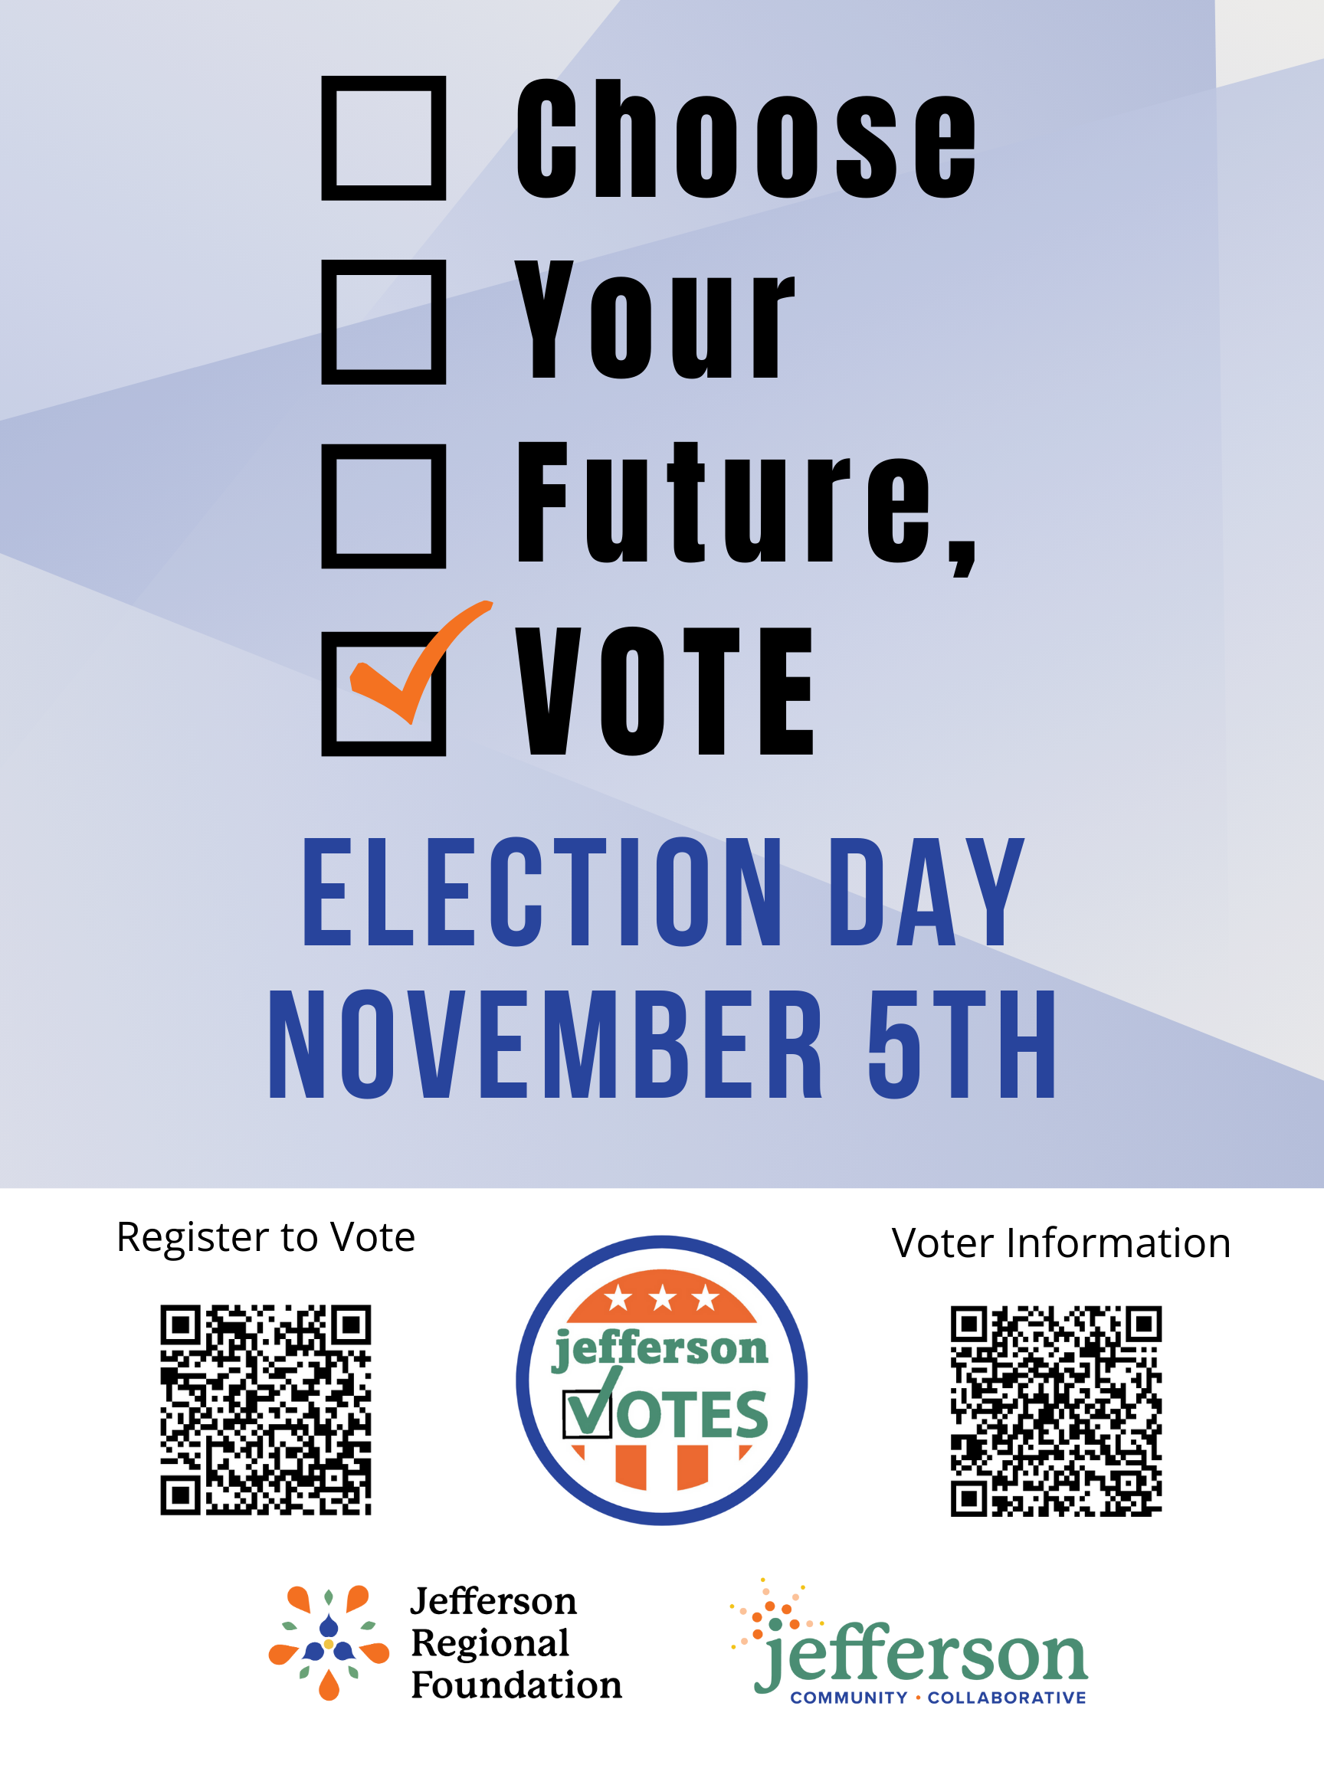
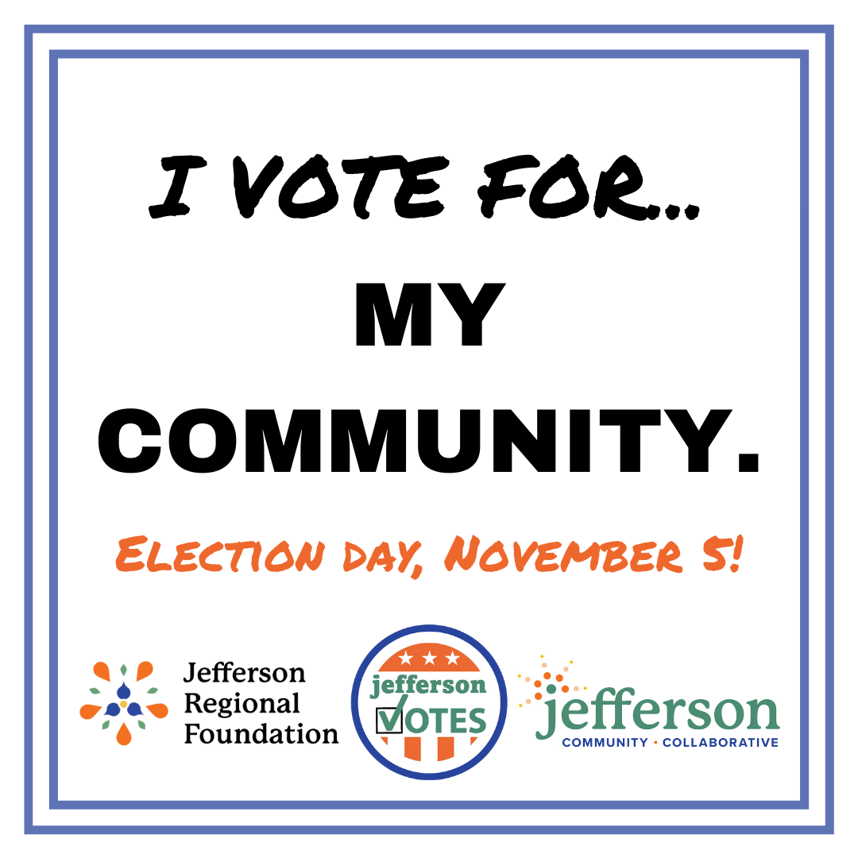
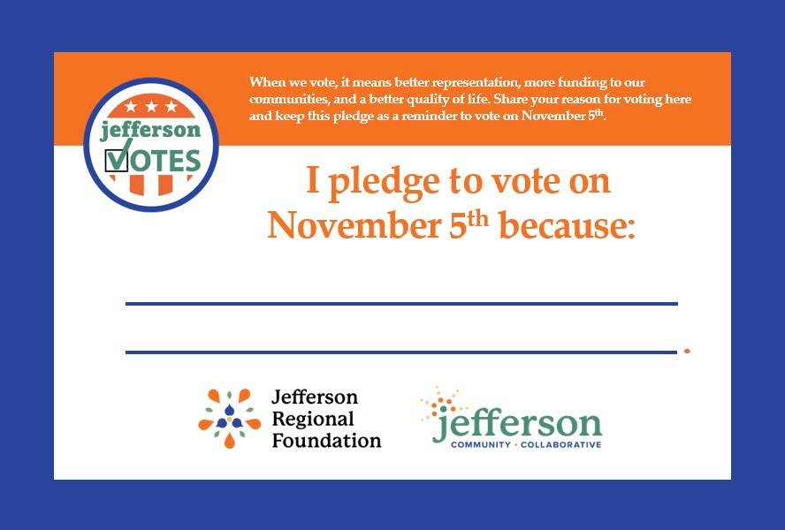
Jefferson Votes Resources
Jefferson Votes Toolkit = Nonpartisan resources that organizations can use in their voter engagement efforts
Notes:
The next piece of the updated Jefferson Votes Initiative is the Jefferson Votes Toolkit
Jefferson Votes Toolkit = Nonpartisan resources that organization can use in their voter engagement efforts
WE HAVE PAPER COPIES OF THE MATERIALS FOR ALL OF YOU AT THE FRONT TABLE, BUT THEY ARE ALSO AVAILABLE ON THE COLLAOBRATIVE WEBSITE FOR YOU TO DOWNLOAD AND UTILIZE. THESE MATERIALS INCLUDE:
An Election Guide with QR codes to register to vote, research candidates, locate polling places, etc.
A pledge card to remind individuals to vote
Sample posters to share and place around spaces
Sample social media content and images
Email templates for internal and external communications
How to utilize these materials?
Share the Election Guide and Pledge Card at your front desk, attach to an email, pass out during meeting.
Display the Jefferson Votes posters around your space or have them available at a front desk
Utilize the Jefferson Votes templates for communicating with staff and constituents the importance of voting
Share the sample social media graphics and content on your own social media
Do not forget to grab copies of the toolkit materials from the table by the door or download from the Collaborative website

Slide 45
Important General Election Dates
PA Voter Registration Deadline: Monday, October 21
General Election: Tuesday, November 5
Notes:
I want to reminder the group of some important dates coming up for the upcoming general election:
The last day to register to vote for the general election in PA is Monday, October 21.
In person – local election office
Online
By mail (must be received by the 21st)
The general election in on Tuesday, November 5
In person until 8:00pm
For those with Mail in or Absentee Ballots
By mail must be received by November 5 at 8:00pm
In person delivered to elections office by November 5 at 8:00pm

Slide 46
Gameshow: Nonprofit Voting Know-How
Notes:
NOW – TO TEST YOUR KNOWLEDGE, IT’S TIME TO PLAY THE GAME THAT IS SWEEPING THE NATION – LEADING UP TO THE GENERAL ELECTION IN NOVEMBER
NONPROFIT VOTING KNOW-HOW
I’M YOUR HOST, DANNY VEREB

Slide 47
Rules of Play
Each Table is a Team
6 Questions (1 Point Each)
First to Wave Flag with Correct Answer = 1 Point
Tiebreaker at End of 6 Questions
Notes:
Here’s how to play the game:
Each Table is a Team
There are 6 questions – each question is worth one point
On your table you might have noticed little flags with the Collaborative and Jefferson Votes logos. The first team to raise their flag and answer the question correctly will receive a point
If there is a tie at the end of the 6 questions, there will be a tiebreaker.
I have the handy JRF staff around to confirm who is the first to raise their flag – so NO Misinformation.

Slide 48
True or False: Nonprofit Voter Engagement
True or False
1) Nonprofit organizations can conduct or promote voter registration.
Answer: True
Notes:
OK – Flags Ready?
True or False
1) Nonprofit organizations can conduct or promote voter registration
Answer: True
YES, NONPROFIT ORGANIZATIONS CAN CONDUCT VOTER REGISTRATION EVENTS AND ACTIVITIES – THIS IS PART OF THE NONPARTISAN WORK THAT WE ARE PROMOTING

Slide 49
True or False: Nonprofit Voter Engagement
True or False
2) Nonprofit organizations with a 501(c)(3) can endorse a candidate.
Answer: False
Notes:
FLAGS READY
True or False
2) Nonprofit organizations can endorse a candidate
Answer: False
NONPROFIT ORGANIZATIONS CANNOT ENDORSE A SPECIFIC CANDIDATE – THEIR SUPPORT MUST REMAIN NONPARTISAN

Slide 50
True or False: Nonprofit Voter Engagement
True or False
3) Nonprofit organizations can distribute nonpartisan sample ballots, candidate questionnaires, or voter guides.
Answer: True
Notes:
FLAGS READY
True or False
3) Nonprofit organizations can distribute nonpartisan sample ballots, candidate questionnaires, or voter guides
Answer: True
NONPROFIT ORGANIZATIONS SHOULD PARTICIPATE IN VOTER ENGAGEMENT WORK. UTILIZE THE JEFFERSON VOTES TOOLKIT TO DOWNLOAD THESE MATERIALS OR GET INSPIRATION FOR YOUR OWN WORK.

Slide 51
True or False: Nonprofit Voter Engagement
True or False
4) Nonprofit organizations can participate in Get-Out-The-Vote efforts.
Answer: True
Notes:
FLAGS READY
True or False
4) Nonprofit organizations can participate in Get-Out-The-Vote efforts
Answer: True
ALONG WITH SHARING REGISTRATION MATERIALS, BALLOT INFORMATION, AND CANDIDATE QUESTIONAIRES, NONPROFITS CAN PARTICIPATE IN GET OUT THE VOTE EFFORTS – JUST REMEMBER TO KEEP YOUR EFFORTS NONPARTISAN

Slide 52
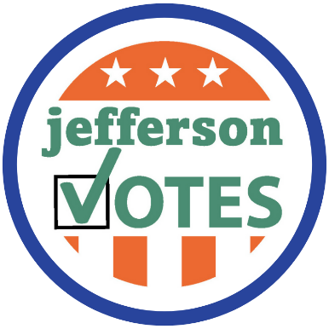
True or False: Nonprofit Voter Engagement
True or False:
5) Nonprofit organizations can make a contribution or expenditure for a candidate.
Answer: False
Notes:
FLAGS READY
True or False
5) Nonprofit organizations can make a contribution or expenditure for a candidate
Answer: False
NONPROFIT ORGANIZATIONS CANNOT CONTRIBUTE TO A SPECIFIC CAMPAIGN, HOWEVER, INDIVIDUALS MAY CHOOSE TO CONTRIBUTE IF THEY DESIRE

Slide 53
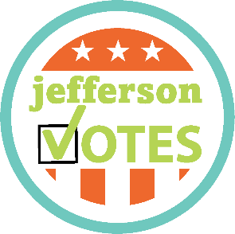
True or False: Nonprofit Voter Engagement
True or False
6) Nonprofit organizations can provide information on when and where to vote – such as finding their polling location, getting an absentee ballot or contacting their local election office.
Answer: True
Notes:
FLAGS READY
True or False
6) Nonprofit organizations can provide information on when and where to vote – such as finding their poll location, getting an absentee ballot or contacting their local election office.
Answer: True
NONPROFIT ORGANIZATIONS SERVE AS TRUSTED COMMUNITY RESOURCES – PLEASE SHARE THE JEFFERSON VOTES WEBPAGES WITH YOUR COMMUNITY MEMBERS AND CONSTITUENTS WHERE YOU CAN FIND ANSWERS TO ALL OF THESE QUESTIONS.

Slide 54
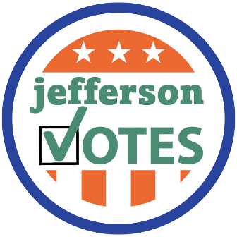
True or False: Nonprofit Voter Engagement
Tie-Breaker: True or False
Nonprofit organizations can send reminders to staff, clients and constituents about voting in the next election and why voting is important
Answer: True
Notes:
Nonprofit organizations can send reminders to your staff, clients and constituents about voting in the next election and why voting is important
Answer: True
SENDING MESSAGING REMINDER STAFF AND COMMUNITY MEMBERS TO VOTE IS PART OF THE NONPARTISAN VOTER ENGAGEMENT WHERE NONPROFIT ORGANIZATIONS SHOULD PARTICIPATE – UTILIZE THE JEFFERSON VOTES TOOLKIT OF THE COLLABORATIVE WEBSITE FOR SAMPLE STAFF AND COMMUNITY COMMUNICATIONS AROUND VOTING
DO WE HAVE A WINNER?
THANK YOU ALL FOR PARTICIPATING
WE WILL HAVE STAFF AROUND TO DISTRIBUTE YOUR PRIZE
THANK YOU FOR PLAYING NONPROFIT VOTING KNOW-HOW

Slide 55
Table Discussions: Jefferson Votes
Task: Working as a group, answer two questions regarding nonpartisan voter engagement:
Table Discussion Questions at Table
Groups will share out with the Collaborative
30 minutes to brainstorm as a group
Notes:
Thank you all for participating in Nonprofit Voting Know-How.
I hope that you all feel more confident, comfortable and emboldened to participate in nonpartisan voter engagement work with your organization.
Now it’s time for all of you to work as a group with your tables to dig a little deeper into nonpartisan voter engagement.
At each of your tables you have a table discussion form with two questions that you and your table partners will have 30 minutes to brainstorm as a group.
Following the brainstorming, you will have the opportunity to share out with the Collaborative.

Slide 56
Table Discussions: Jefferson Votes
Question 1: How does your organization incorporate nonpartisan voter engagement in their work? How might your organization utilize the Jefferson Votes materials to enhance this work? What additional technical assistance would be helpful in nonpartisan voter engagement efforts?
Question 2: How can you leverage existing networks to amplify nonpartisan voter engagement efforts? Who are potential partners in this work?
Notes:
Bring individuals up to report out while questions are up

Slide 57
Community Shares and Final Remarks
Notes:
Thank you all for sharing about nonpartisan voter engagement.
Please leave the forms at your table and a JRF staff member will collect at the end of the day.

Slide 58
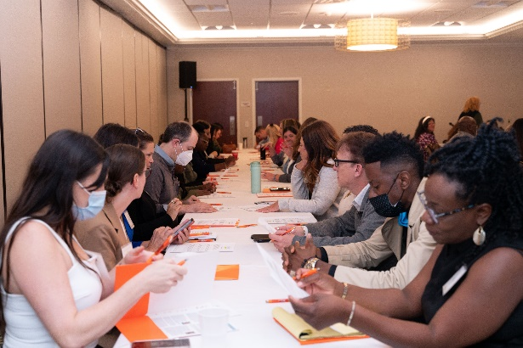
Collaborative Meeting Survey
Please complete the ANONYMOUS Collaborative Meeting Survey during Community Shares
Notes:
OK – hold on now! We are shaking things up and doing things a little differently this time.
On the back of the agenda for this meeting in addition to a QR code with a list of attendees for this meeting, you will also find a QR code to complete your survey about this meeting.
Please take a moment to complete this survey during Community Shares.
IF you prefer to complete this form with pen and paper, please raise your hand and a JRF staff member will be around to provide a paper copy to fill out.

Slide 59
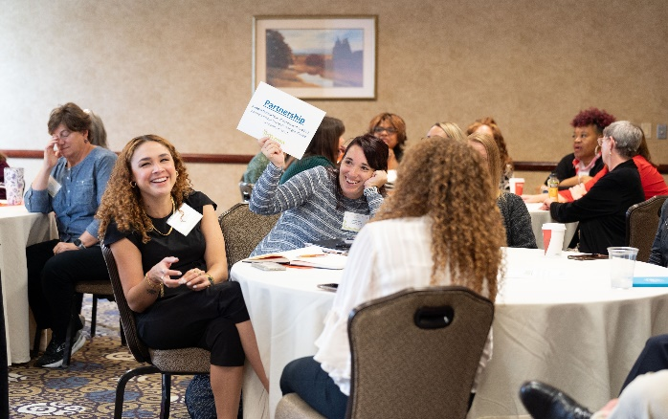
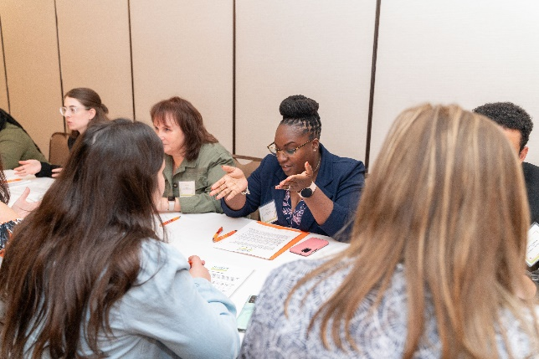
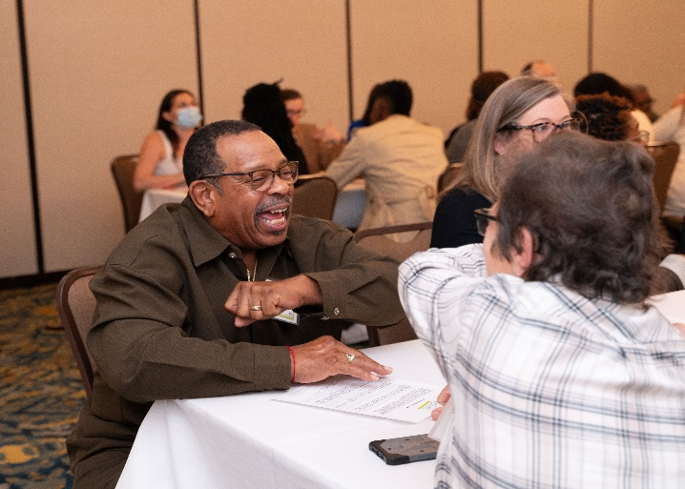
Community Shares
Share a brief announcement or update with the Collaborative!
Notes:
If you signed up at the registration table, you will be called up to the podium to share a brief announcement or update from your organization.
I will call the person who is up and the person on deck.

Slide 60
Save the Date: Upcoming Collaborative Meeting
Thursday, November 21: 8:30-11:00am
Commonwealth Charter Academy (Homestead)
Racial Wealth Gap Simulation (United Way)
Notes:
Quick Note for Calendars - NEXT Collaborative Meeting will be held on Thursday, November 21 from 8:30-11:00am at Commonwealth Charter Academy in Homestead – think the old Macy’s at the Waterfront.
As Dr. Howell mentioned, the focus of this meeting will be a Racial Wealth Gap Simulation conducted by the United Way of Southwestern PA.
Please save the date for this meeting. An invitation will go out in October.

Slide 61
Before You Go
Meeting Survey
Jefferson Votes Materials
Network
MVCAF Convenings
Notes:
Before You GO…
Take a moment to complete the anonymous meeting survey
There is a QR code back page of the agenda
If you would like a paper copy, please let a staff member know!
Before you leave, grab the Jefferson Votes materials that are available near the front door. Please utilize the materials on the Collaborative website for all your needs.
Be sure to RSVP for the MVCAF convenings and share the information about our convenings broadly with your network when the email goes out next week.
Speaking of networks, please take the opportunity to connect and network with fellow nonprofit partners.

Slide 62
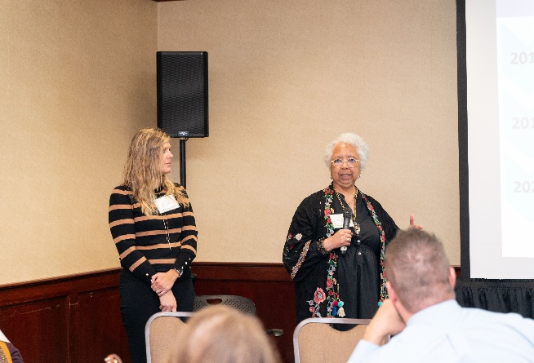
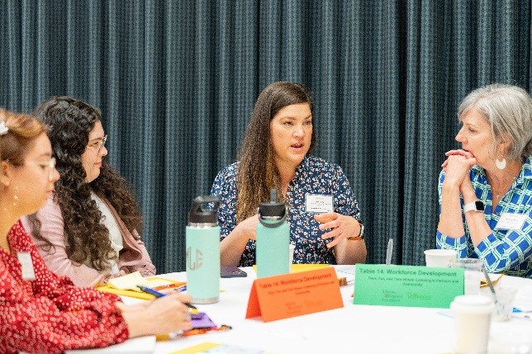
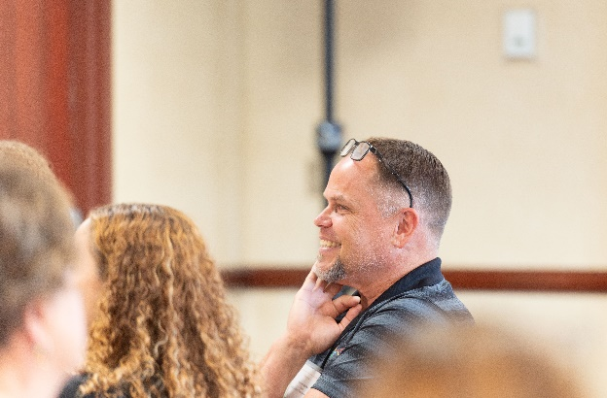
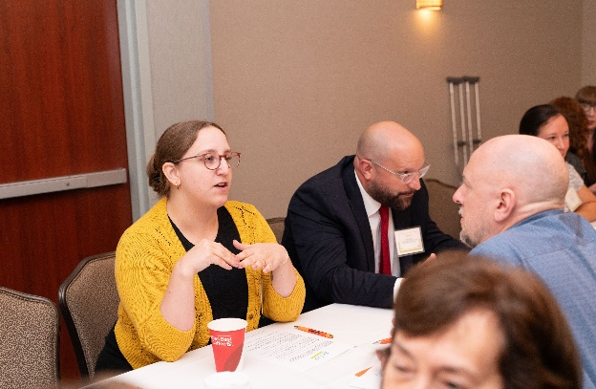
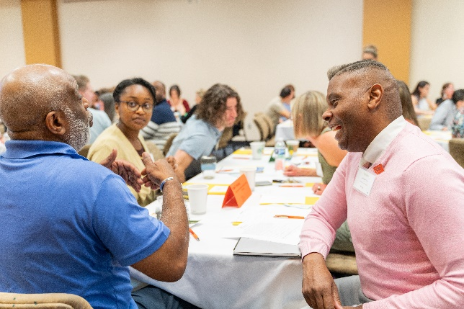
Thank you for sharing your time, passion and insights with us!
Notes:
Thank you for coming today!
Special thanks to:
Salvatore’s for hosting us today
The Civic and Policy Engagement Action Team for taking the time to work on and update the Jefferson Votes materials.
We look forward to seeing you in November. Have a safe and healthy summer!

